Slide 2

Unit 2: Using SQL Workshop

Slide 3
Lesson Objectives
After completing this lesson, you should be able to:
Describe SQL Workshop and list its components
Browse through database objects using the Object Browser
Create and modify database objects
Create a lookup table
Run SQL commands and SQL scripts
Load and unload data using Data Workshop utility
Build a SQL query using Query Builder
Generate SQL using Quick SQL
Generate DDL statements
Notes:
In this lesson, you are introduced to the SQL Workshop. You learn how to interact with the database by using the different components of SQL Workshop.

Slide 4
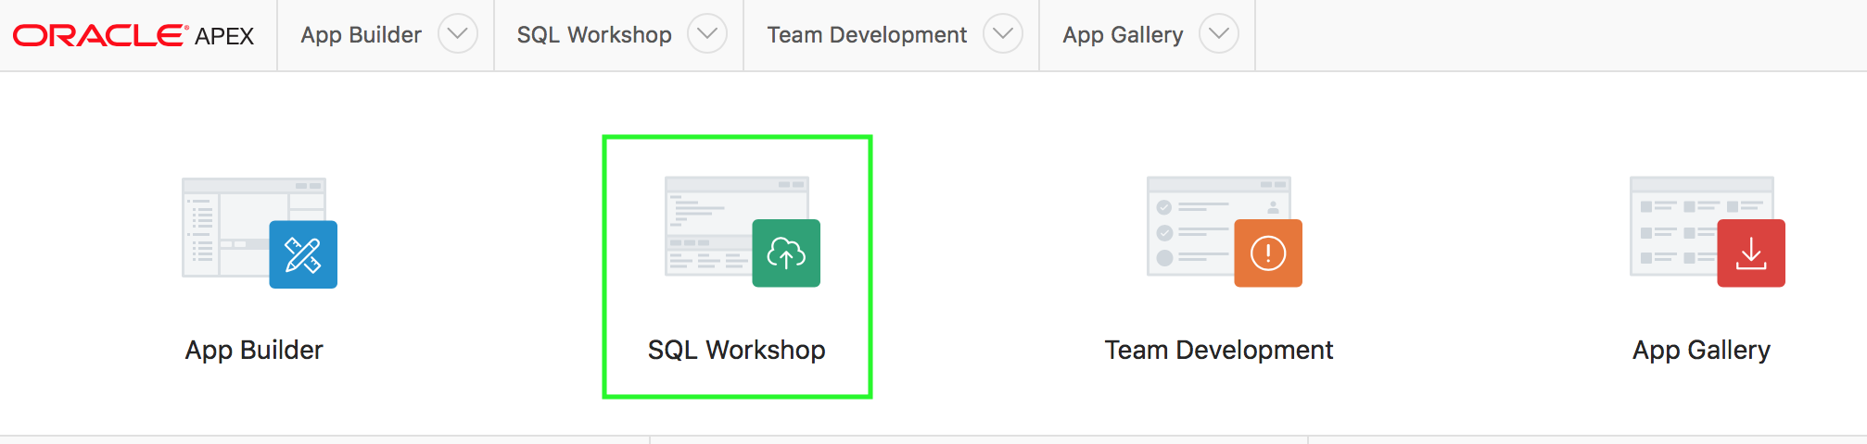
What is SQL Workshop?
SQL Workshop provides tools to view and manage database objects
Notes:
Oracle Application Express includes the SQL Workshop for application developers to maintain database objects, from the browser. This feature is particularly important when developing in hosted environments, or where the application developer does not have access to the underlying database and can not use tools such as SQL Developer or SQL*Plus to manage the database objects.

Slide 5
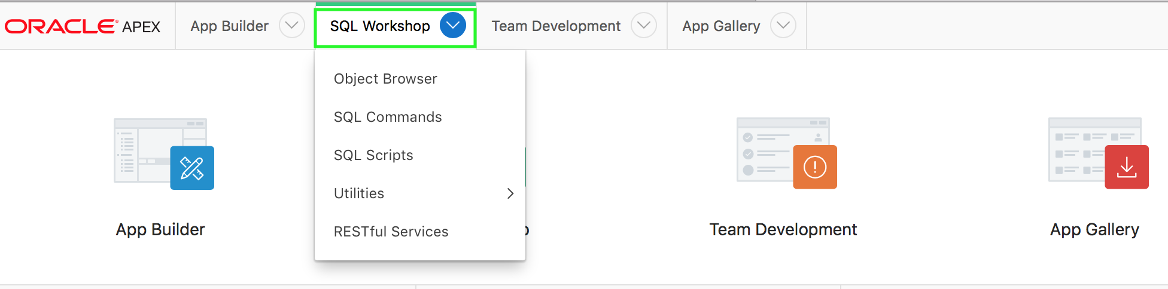
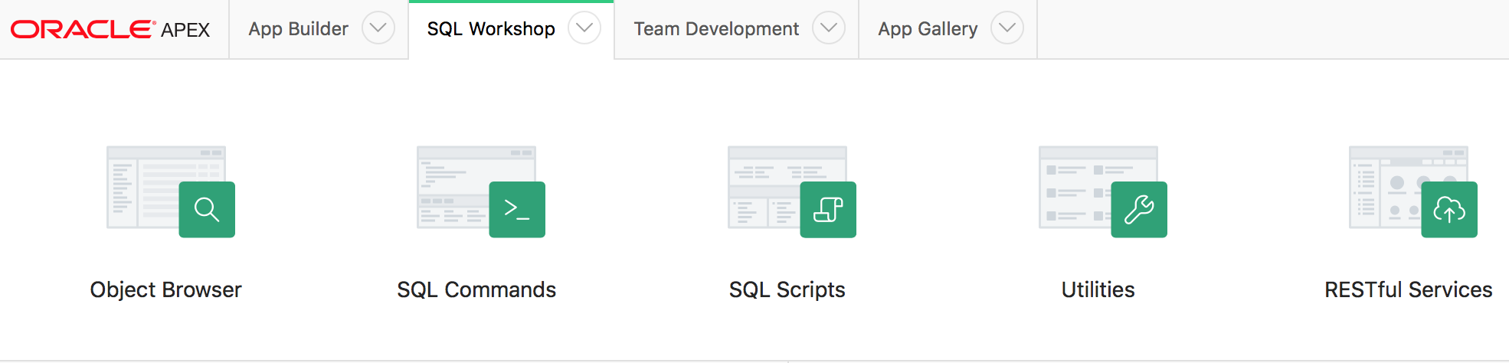
Accessing SQL Workshop Components
1
2
Notes:
From the Application Express home page, you can access SQL Workshop by either of the following two ways:
Click the SQL Workshop icon and then select the component you want to access
Click the down arrow on the SQL Workshop tab. Then, select the component you want to access
The slide shows the two steps to access a SQL Workshop component.
Click the down arrow on the SQL Workshop tab.
Select any of the components you want to access: Object Browser, SQL Commands, SQL Scripts, Utilities, and RESTful Services.

Slide 6
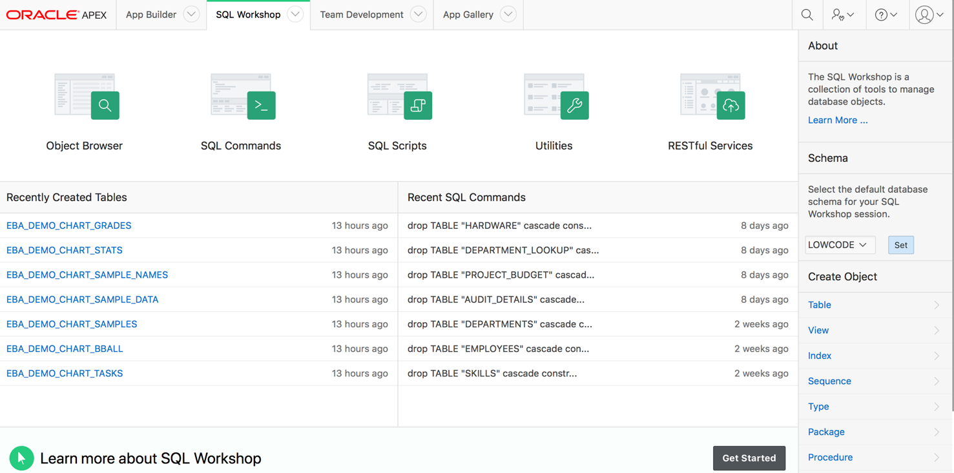
Using SQL Workshop Components
Load and unload data, generate DDL
Declaratively specify RESTful services
Store and run scripts
Enter and run SQL
Create database objects and view database object properties
Notes:
The SQL Workshop provides tools that enable you to view and manage database objects. Based on the task, you use the following component of SQL Workshop:
Object Browser: This component enables developers to browse, create, and edit objects in a database
SQL Commands: You use SQL Commands to create, edit, view, run, and delete database objects. A SQL command can contain SQL statements or PL/SQL blocks.
SQL Scripts: A SQL script is a set of SQL commands saved as a file in SQL Scripts. A SQL script can contain one or more SQL statements or PL/SQL blocks. You use SQL Scripts to create, edit, view, run, and delete database objects..
Utilities: You use Oracle Application Express utilities to build SQL queries, load and unload data from an Oracle database, generate DDL, view object reports, manage User Interface Defaults, restore dropped database objects, compare schemas, monitor the database, and view database details
Restful Services: RESTful Services enable the declarative specification of RESTful services used to access the database. These services work with the Oracle REST Data Services (formerly known as Oracle Application Express Listener) to enable the consumption of these services. This component helps you to create, edit and delete RESTful Services. If the instance administrator has disabled RESTful Services for this Application Express instance, RESTful Services are not available for this instance and the RESTful Services icon does not display.

Slide 7
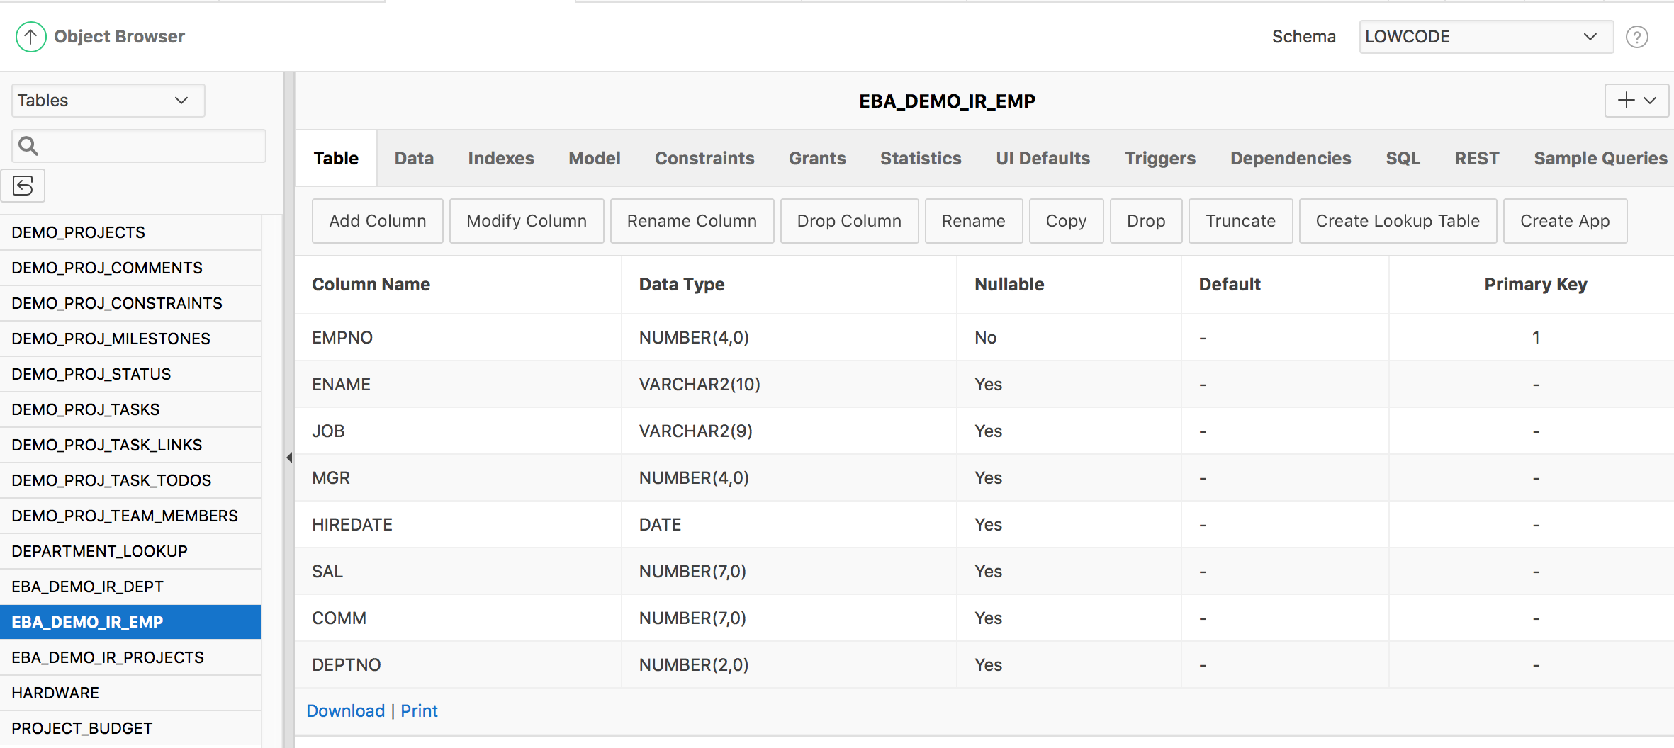
Managing Database Objects with Object Browser
Object Selection Pane
Detail pane
Notes:
Object Browser enables developers to browse, create, and edit objects in a database. To access Object Browser, on the Workspace home page, click SQL Workshop. Then click Object Browser. The Object Browser page is divided into two panes: Object Select Pane: This pane displays on the left side of the Object Browser page. It lists database objects of a selected type within the current schema. You can further narrow the results by filtering on the object name.
Detail Pane: This pane displays to the right of the page. It displays detailed information about the selected object.
To view object details, select an object in the Object Selection pane. Click the tabs at the top of the Detail pane to view additional details about the current object. To edit an object, click the appropriate button. The graphic shows DEMO_ORDERS table is selected and the detail information of this table is displayed in the Detail pane. To create an object:
Click the Create icon (+), located in the upper right corner of the Detail pane.
From the list of object types, select the type of object you want to create. Follow the on-screen instructions.

Slide 8
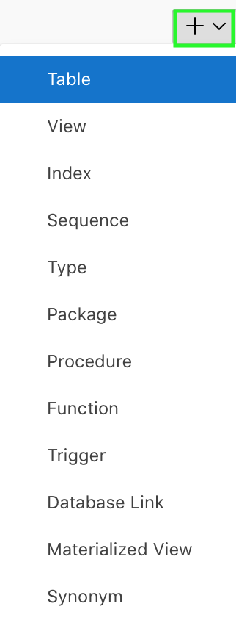
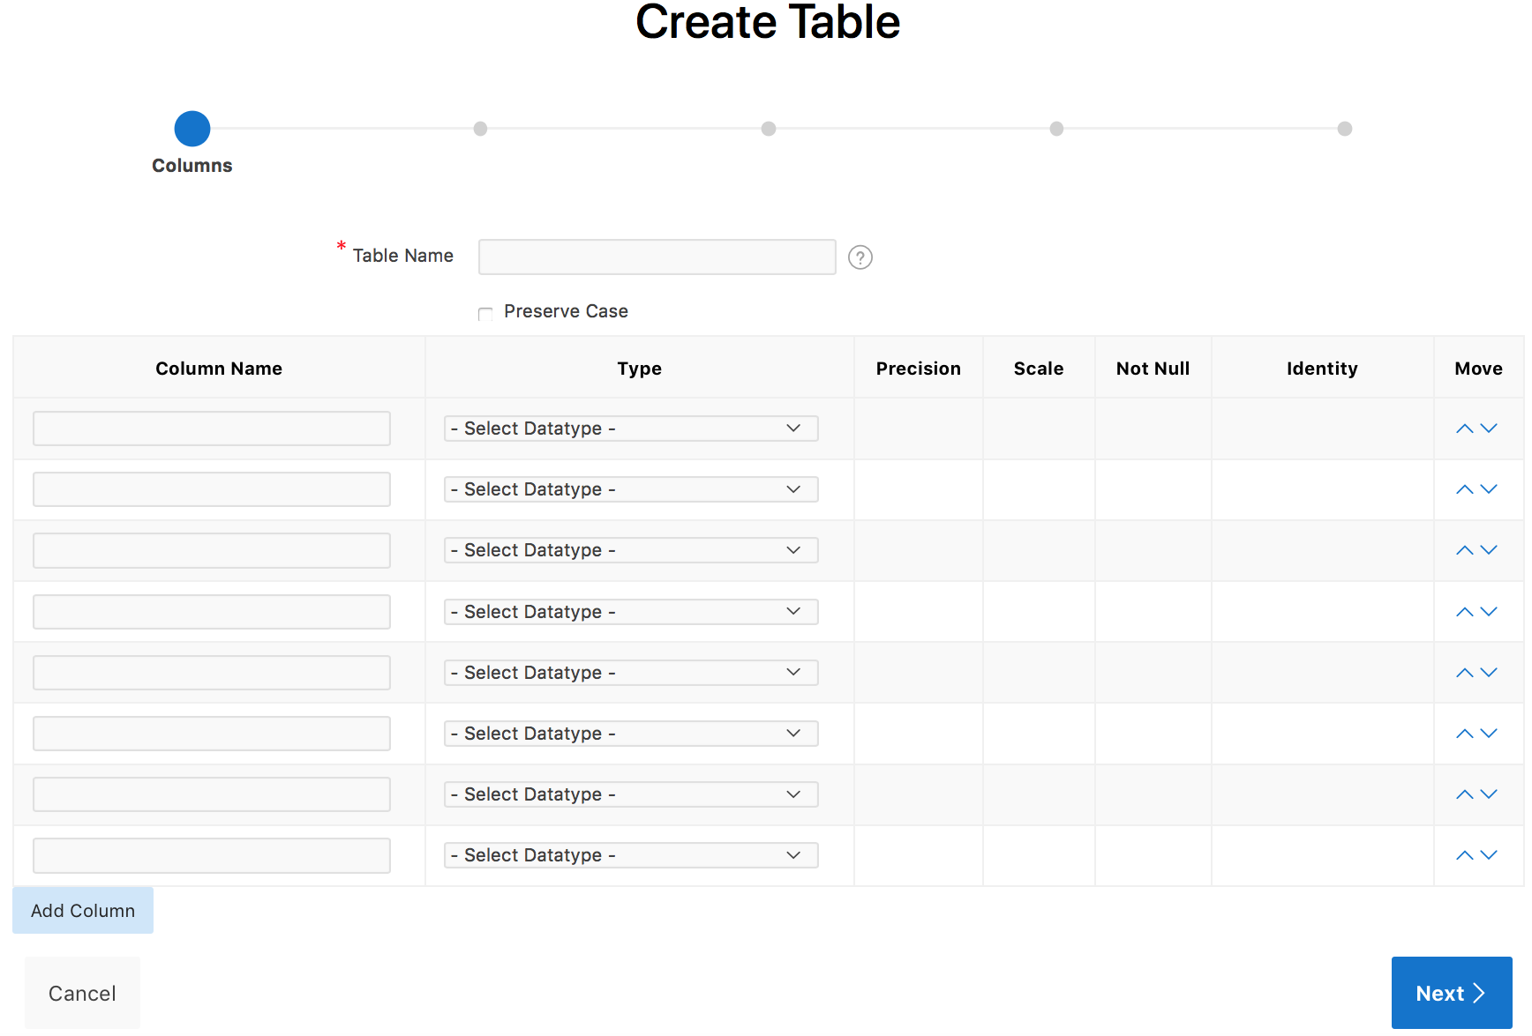
Creating a Database Object
1
2
Notes:
The slide shows how to create a table in Object Browser. You create database objects using the Create Database Object Wizard. Once you select an object, a set of tabs and buttons appears at the top of the Detail pane. To create an object, perform the following steps:
Click the Create icon (+), located in the upper right corner of the Detail pane.
From the list of object types, select the type of object you want to create. Follow the on-screen instructions.

Slide 9
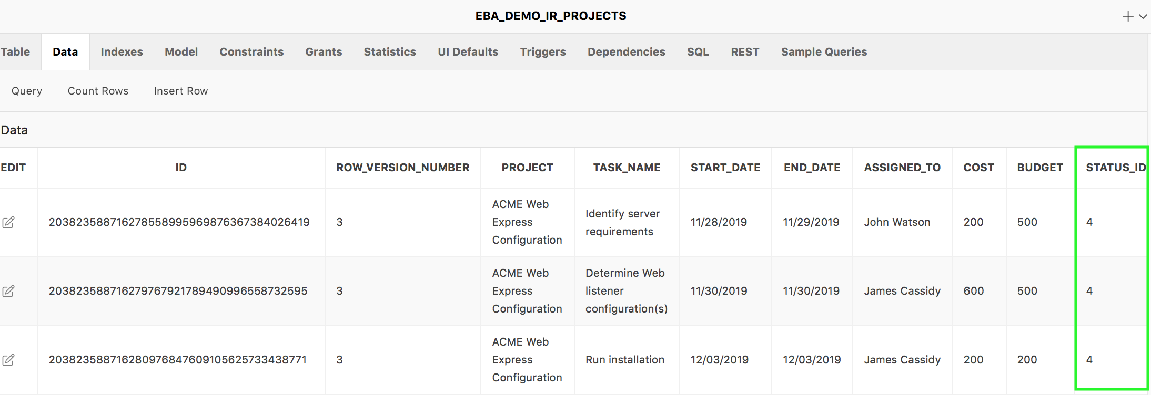
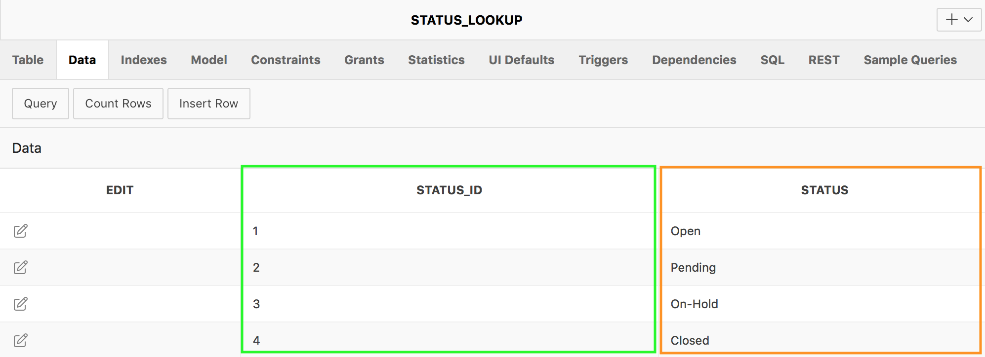
Creating a Lookup Table
STATUS column is extracted from EBA_DEMO_IR_PROJECTS table
Lookup table
Notes:
Using the Object Browser, you can create a lookup table. A lookup table is a new table that is created by extracting a column from an existing table. A new primary key column is created in the new table and a foreign key is created between the source table and the new lookup table. The slide shows that a new look up table STATUS_LOOKUP is created by extracting the STATUS column from the existing EBA_DEMO_IR_PROJECTS table. A primary key column in the new STATUS_LOOKUP table, and a foreign key to the EBA_DEMO_IR_PROJECTS table are created. The lookup table contains the column that you selected when you created the table (for example, STATUS) as well as a new ID column (STATUS_ID).

Slide 10
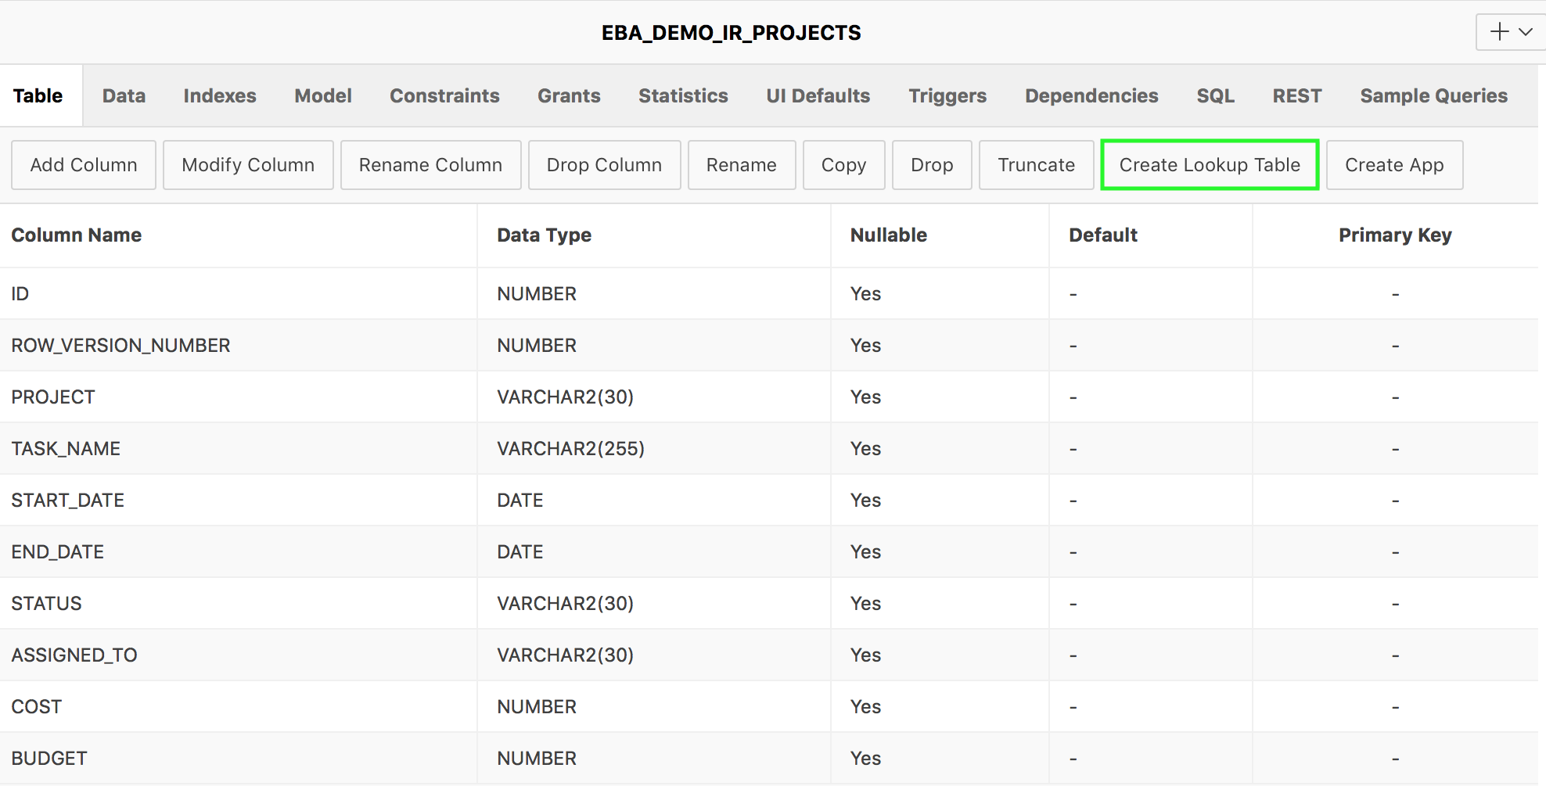
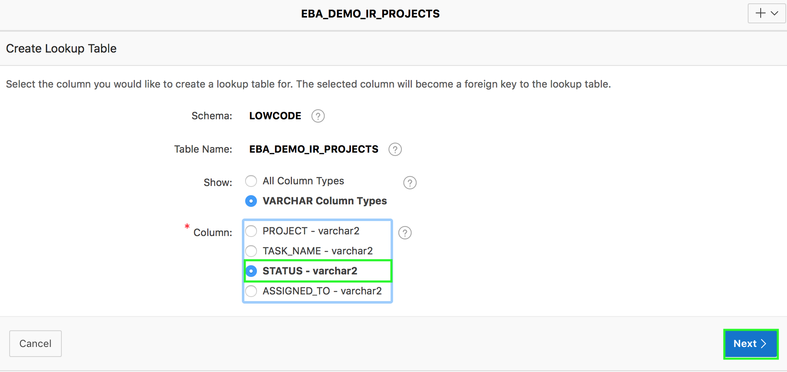
Creating a Lookup Table: Steps
1
2
Notes:
Steps to create a lookup table:
From the object selection pane, select the table for which you want to create a lookup table. In the detail pane: Click the Create Lookup Table button. In the slide example, you select the EBA_DEMO_IR_PROJECTS table.
Select the column that you want to use to create the lookup table. Click Next. In the slide example, you select STATUS.

Slide 11
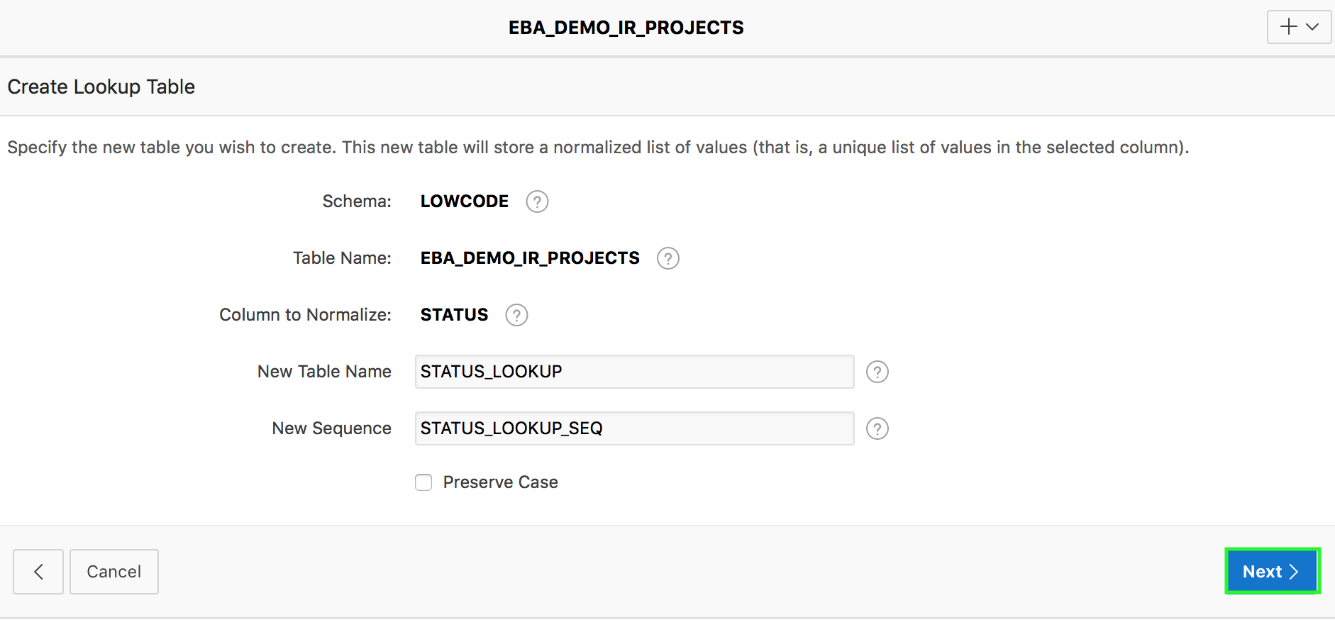
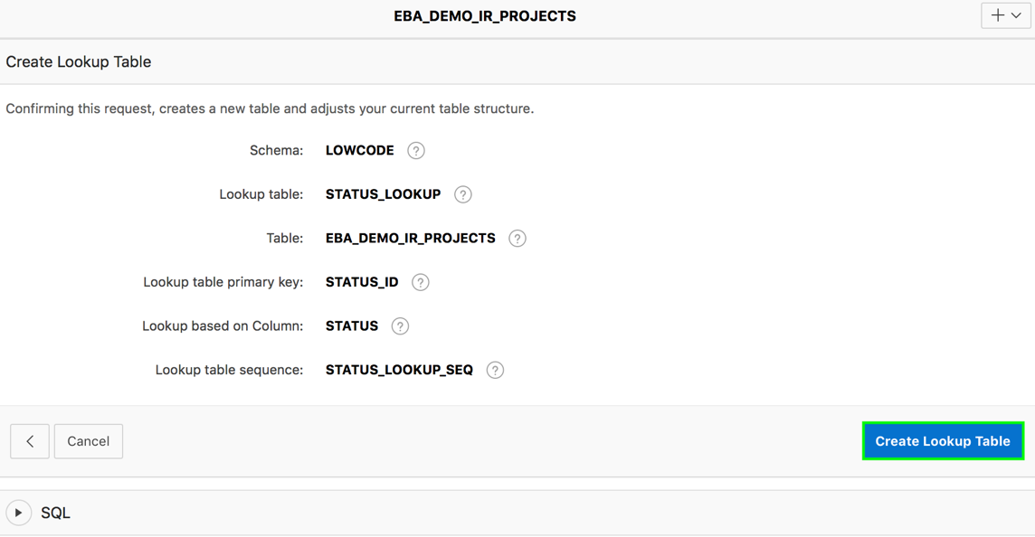
Creating a Lookup Table: Steps
3
4
Notes:
Change the name of the lookup table or sequence (optional step). Click Next.
Click Create Lookup Table.

Slide 12
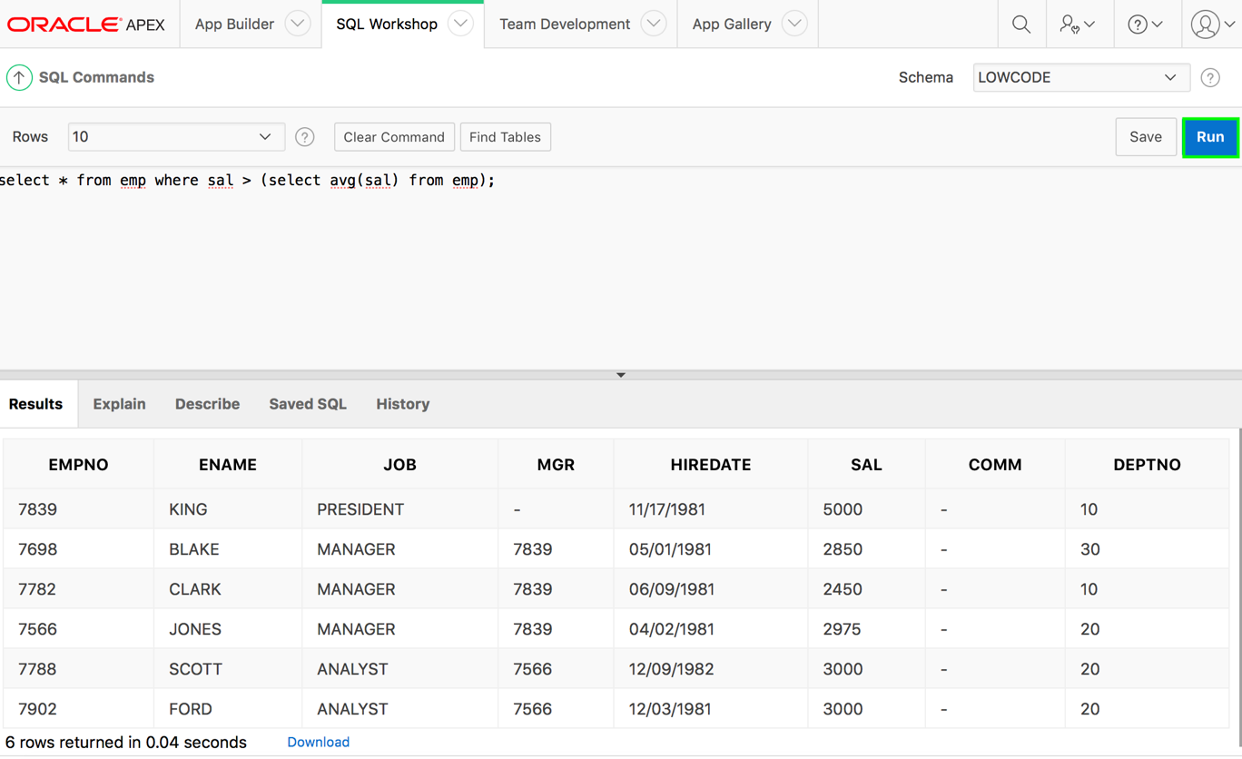
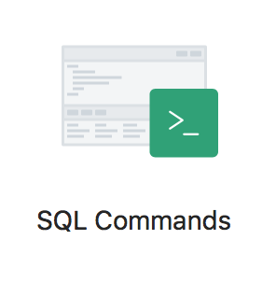
Executing SQL Commands
Command editor
Display Pane
Notes:
You use SQL Commands to create, edit, view, run, and delete database objects. A SQL command can contain SQL statements or PL/SQL blocks. The SQL Commands home page is divided into two sections: a command editor and a display pane. You use the command editor to execute SQL commands and the display pane to view output, saved command lists, and history lists. The graphic shows a SQL Command is executed and results are displayed in the display pane. To execute a SQL command:
Select SQL Workshop > SQL Commands
Enter the SQL or PL/SQL statement in the command editor
Click the Run button
View the output on the Results tab of the display pane
Click the Download link to export the results of the query to a spreadsheet (optional step)

Slide 13
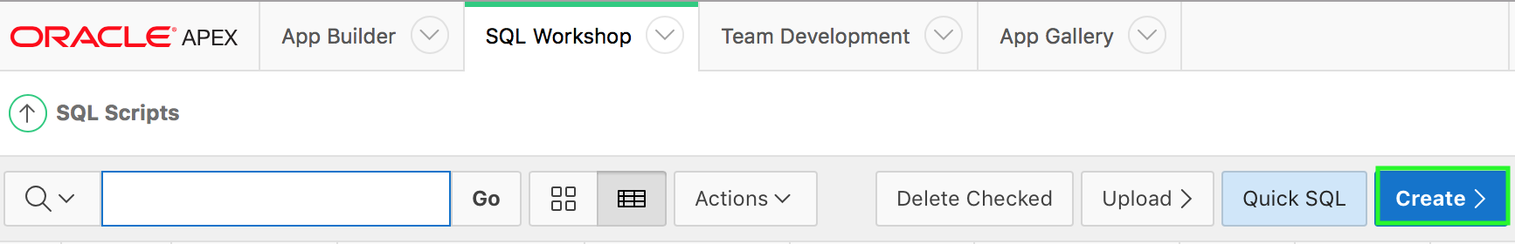
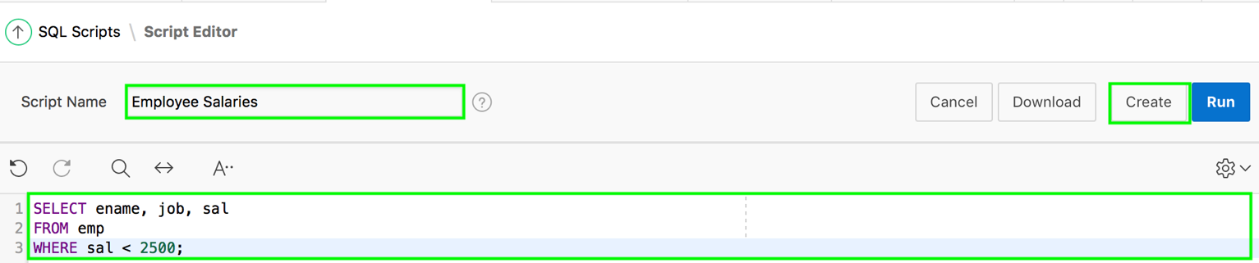
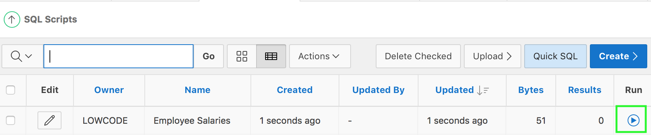
Creating and Running SQL Scripts
1
2
3
Notes:
You use SQL Scripts to create, edit, view, run, and delete script files. The slide shows steps involved in creating and running a SQL script.
Navigate to SQL Workshop > SQL Scripts. Click the Create button.
Enter a name for Script Name. Enter the SQL statements, PL/SQL blocks you want to include in your script. Remember that SQL*Plus commands are ignored at runtime. Click Create.
The SQL Scripts page appears listing your newly saved script. You can now run this script.
You can upload a script from your local file system. Perform the following steps:
Navigate to SQL Workshop > SQL Scripts.
Click the Upload button. The Upload Script dialog appears.
Click Browse to locate the script you want to upload. Optionally enter a new name in the Script Name field. This name displays in the Script Repository.
Click Upload. The SQL Scripts page appears listing your newly uploaded script. You can now run the SQL script that you just uploaded.

Slide 14
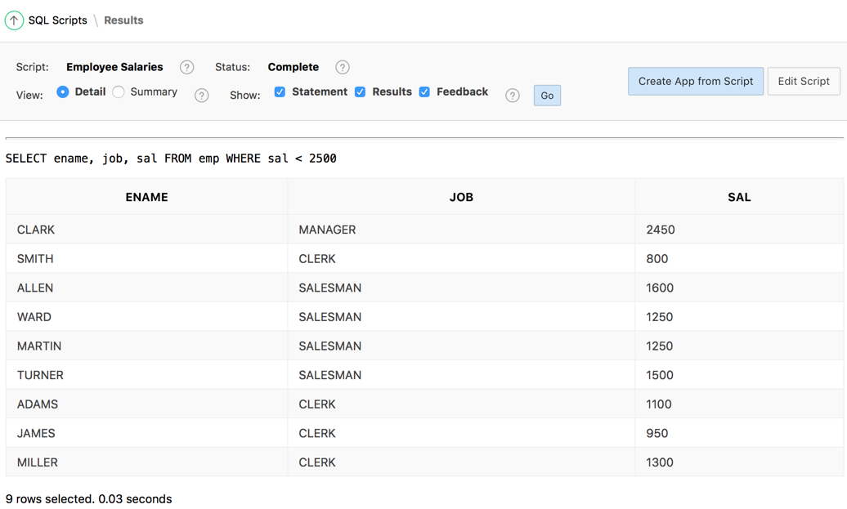
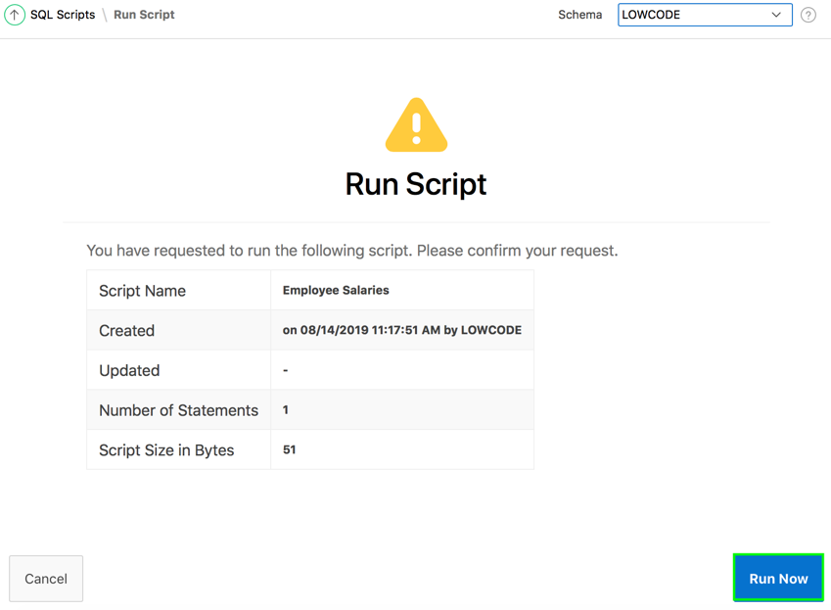
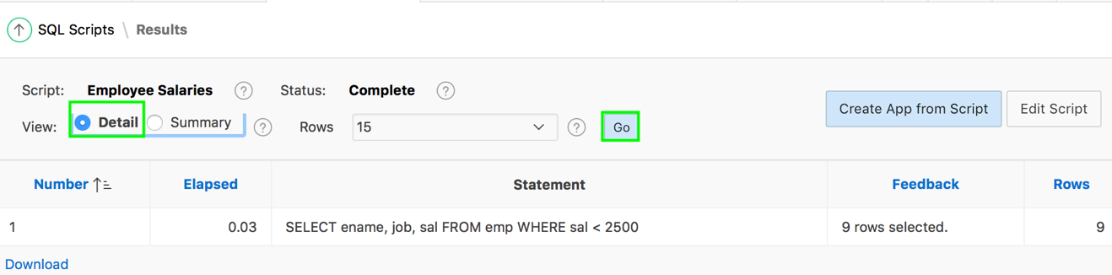
Viewing SQL Scripts Results
3
1
2
Notes:
This slide shows how to view the results of the SQL script that you created in the previous slide. Perform the
following steps:
First, click the Run button for the script that you created. Then, click Run Now.
The Results page displays a summary. To view details, select Detail radio button and click Go.
Now, you see the script along with the results in detail.

Slide 15
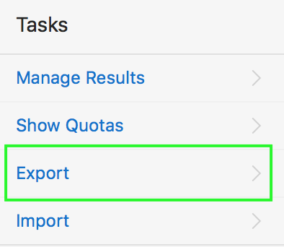
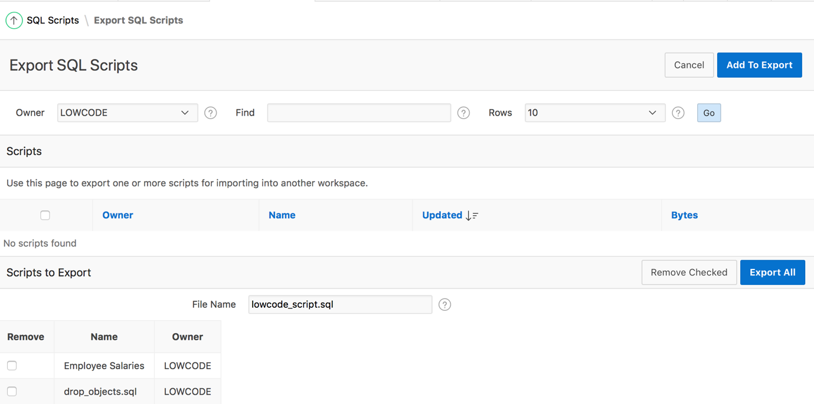
Exporting and Importing SQL Scripts
Notes:
You can transfer scripts from your current Script Repository to a Script Repository in a different workspace by using the Export and Import tasks. Exported scripts are encoded in a single file on your local file system. Once exported, you then log in to another workspace and import the file. During import, the file is run to re-create the scripts in the current Script Repository.
By default, the Export SQL Scripts page lists all scripts in the Script Repository created by the current user. The slide shows that there are two panes on the Export SQL Scripts page: the Scripts pane and the Scripts to Export pane. You use the Scripts pane to select scripts to export. Then, you use the Scripts to Export pane to finalize the scripts to export, to choose a name for the export script, and to save the selected scripts in the export script on your local file system.
To export a script, perform the following steps:
Navigate to SQL Workshop > SQL Scripts.
On the Tasks list, click Export. The Export SQL Scripts page appears.
Select the scripts you want to export. To select all displayed scripts, click the column head check box. Click Add to Export.
The selected scripts are added to the list of scripts in the Scripts to Export pane. Enter a name for the export script in the File Name field. The default script name is workspace_name_script.sql.
Click Export All to export the scripts to the export script. You are prompted to enter the directory where you want to save the export script.
You can import a script file exported from a different workspace into your current workspace. Note that only script files exported from the scripts repository can be imported. If you try to import any other script, you see a “script not compatible” error. To import a script, perform the following steps:
Click Import on the Tasks list.
Click the Browse button and locate the file to import from your local file system.
Then, click Next and click Import Scripts.

Slide 16
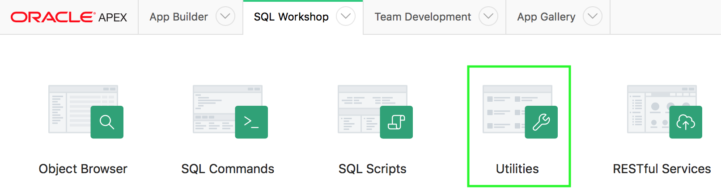
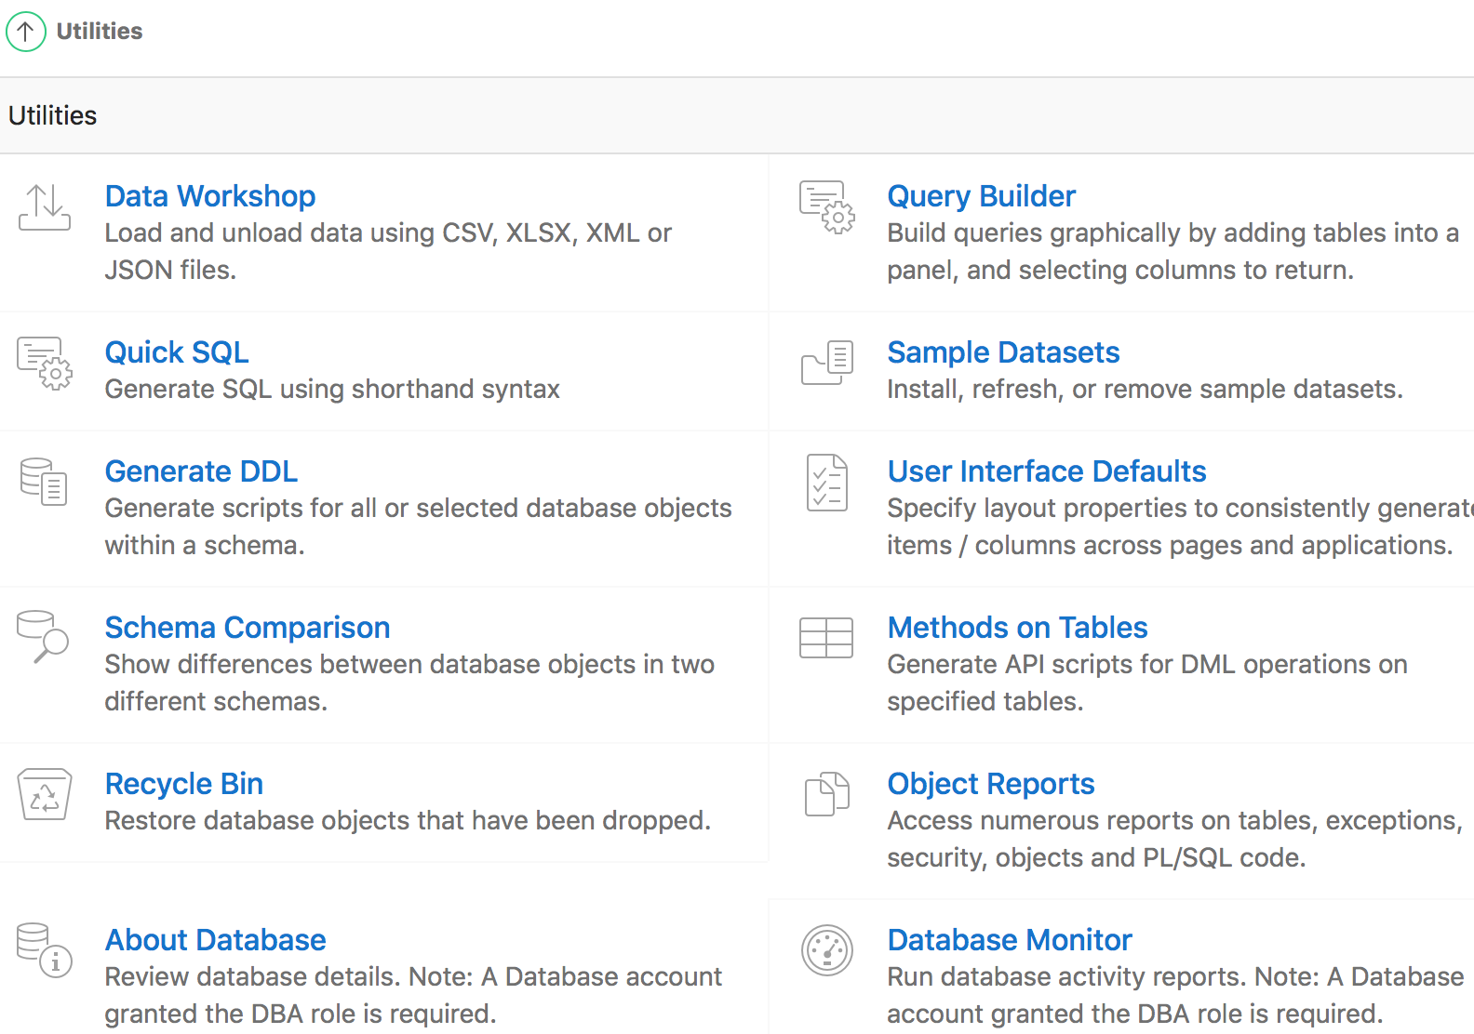
Using Oracle Application Express Utilities
1
2
Notes:
Oracle Application Express provides utilities to build SQL queries, load and unload data from an Oracle database, generate DDL, view object reports, manage User Interface Defaults, restore dropped database objects, compare schemas, monitor the database, and view database details. This lesson covers some of these utilities.
The slide shows navigating to the Utilities page.
On your Workspace home page, click SQL Workshop. Then, click Utilities.
The Utilities page appears.

Slide 17
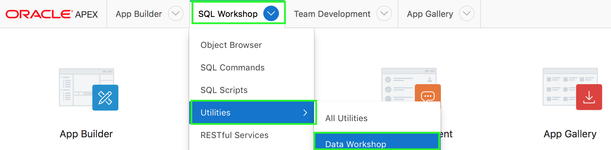
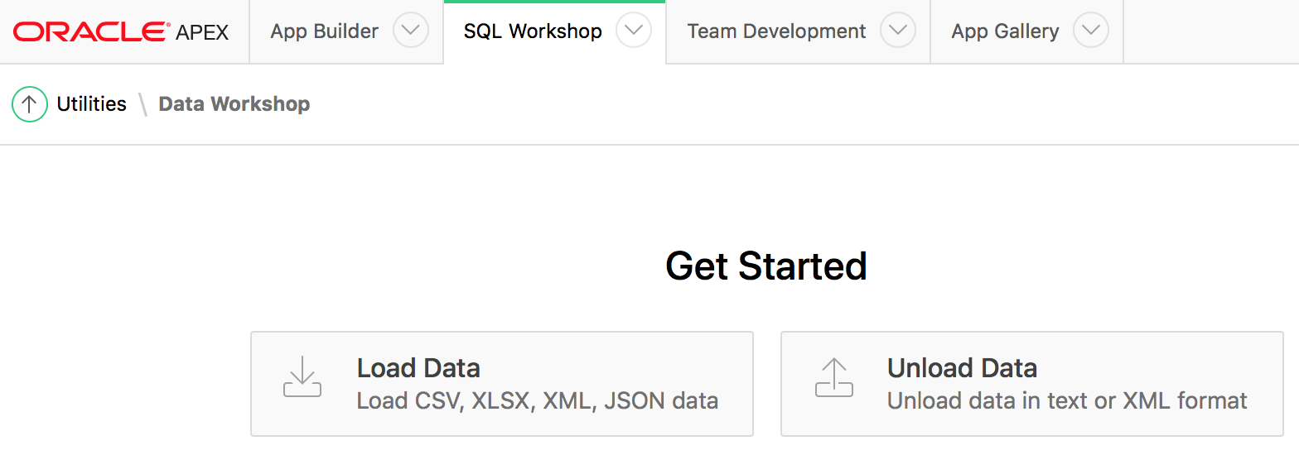
Loading and Unloading Data Using Data Workshop
Use the Load Data Wizard to load from various files formats into your workspace and Unload Data Wizard to export your data in text or XML format.
1
2
Notes:
Use the Load Data Wizard to load from various files formats into your workspace and Unload Data Wizard to export your data in text or XML format.
The slide shows the steps to access the Data Load/Unload page:
Click the down arrow on the SQL Workshop tab.
Select Utilities. Then, select Data Workshop. The Data Workshop page appears.
Alternatively, to access the Data Load/Unload page, perform the following steps:
On the Workspace home page, click the SQL Workshop icon.
Click Utilities.
Click Data Workshop. The Data Workshop page appears.
Click the appropriate icon to load data or unload data.

Slide 18
Using the Load Data and Unload Data Wizards
Upload or Drag and drop delimited files (CSV, tab-delimited), XLSX files (Excel workbooks), JSON, or XML files to load data into a new table
Copy and paste delimited data (CSV, tab-delimited), or select a sample data set to load data into a new table
The wizards only load and unload table data. They do not load or unload other kinds of schema objects
You can load and unload to and from your own schema only
You can load or unload only a single table at a time
Supported unload formats include:
Text such as comma-delimited or tab-delimited data in dialog page
XML documents
Notes:
The Load Data and Unload Data step-by-step wizards include the following features:
Drag and drop delimited files (CSV, tab-delimited), XLSX files (Excel workbooks), JSON, or XML files to load data into a new table.
Copy and paste delimited data (CSV, tab-delimited), or select a sample data set to load data into a new table.
Data load parser detects almost everything automatically so there is no need to manually pick data types, or provide format masks or decimal characters.
Data Loading runs in the background which offers a number of advantages. If a larger file is being uploaded, the dialog can be dismissed. If bad rows cannot be inserted into the target table, the whole load is not lost. All failed rows are saved in error table and can be post-processed manually.
The main dialog displays up to 10 columns and 5 rows in the preview. You can configure load settings such as column headers, file encoding, column delimiter / enclosed by (for CSV or TXT), and Select Sheet (for XLSX with multiple worksheets).
You can view a full preview and change more settings by clicking the Configure button. The Configure dialog displays a maximum of 100 columns and 100 rows. Users can configure the same setting as settings in the main dialog plus maximum Rows to Sample and columns to load/unload.
Settings changes will change the preview both in main and configure dialogs. They also affect data load result.
The wizards only load and unload table data. They do not load or unload other kinds of schema objects.
You can load and unload to and from your own schema only. This is also true for users with administrator privileges.
You can load or unload only a single table at a time.
The following are the supported unload formats:
Text such as comma-delimited or tab-delimited data
XML documents

Slide 19
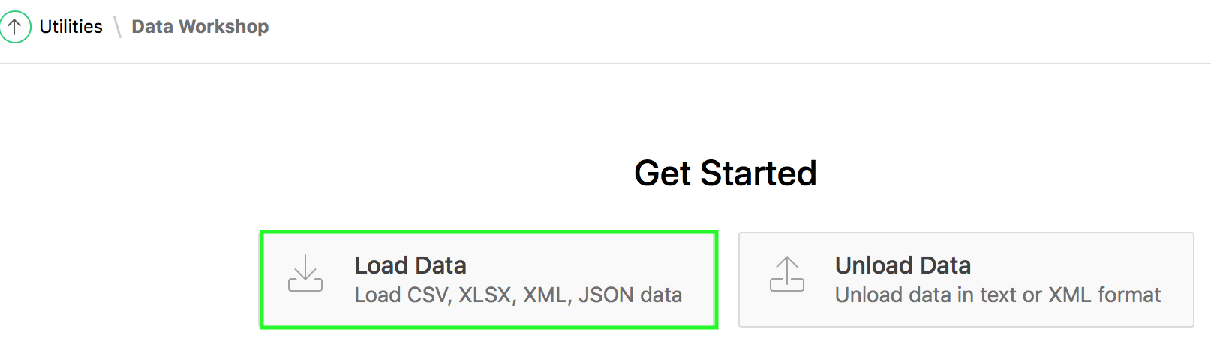
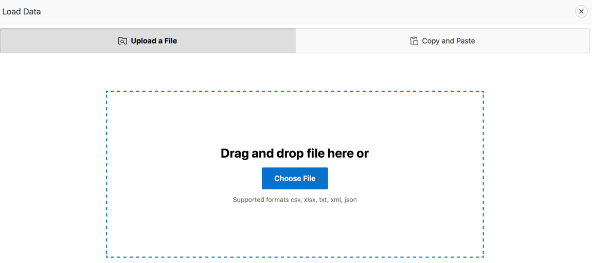
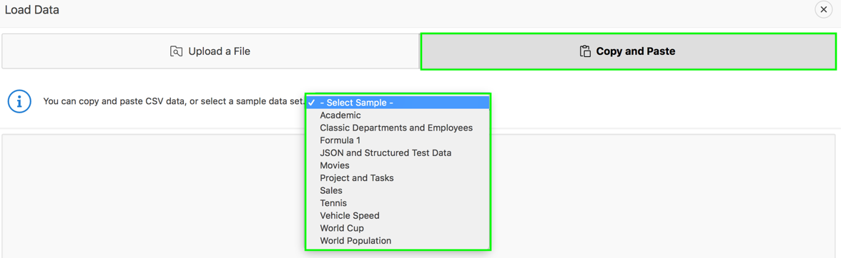
Loading Data Using the Load Data Wizard
Upload or drag and drop a file: CSV, XLSX, TXT, XML or JSON
Copy and paste CSV data
Select a sample data set
Notes:
Using the Load Data wizard, You can load data into the Oracle Application Express database in the following ways:
Copying and pasting CSV data or selecting a sample data set
Drag and drop a file or uploading a file. Supported formats include CSV, XLSX, TXT, XML, and JSON

Slide 20

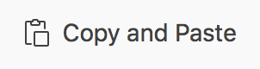
Loading Data: Steps
Navigate to SQL Workshop > Utilities.
Click Data Workshop and then click Load Data.
Under Upload a File, Click Choose File.
Select the appropriate file (CSV, XLSX, TXT, XML or JSON)
Follow the on-screen instructions
Navigate to SQL Workshop > Utilities.
Click Data Workshop and then click Load Data.
Click Copy and Paste.
Under Copy and Paste, you can either copy and paste CSV data or select a sample data set from the drop down menu.
Follow the on-screen instructions
Notes:
The slide shows steps involved in the Load Data Wizard when you choose to either Upload a file or Copy and Paste data. You can also simply drag and drop a CSV, XLSX, TXT, XML or JSON file in to the center of the Load Data dialog.
Oracle Application Express supports only "flat" XML structures which can easily be mapped to a table and columns. XML structures with multiple levels of nesting cannot be loaded by the Data Loading wizard.
Loading JSON files works similar to loading XML files. Only flat structures are supported - deeply nested JSON structures cannot be loaded. JSON files are limited to 20MB on 11g and 12.1 databases. For Oracle Database 12.2 or higher, there is no size limit for JSON files.
Loading XLSX files is similar to loading CSV files. There is no need to detect or to choose delimiter or enclosing characters. If the uploaded XLSX file contains multiple worksheets, Load Data wizard picks the first sheet by default. To load another sheet, pick it from the Select Sheet select list. The First lines contains headers checkbox works similar to CSV files. The same is true for the Configure dialog, the behavior is the same as it is for CSV files. Uploading XLSX files is limited to 20MB for each file.

Slide 21
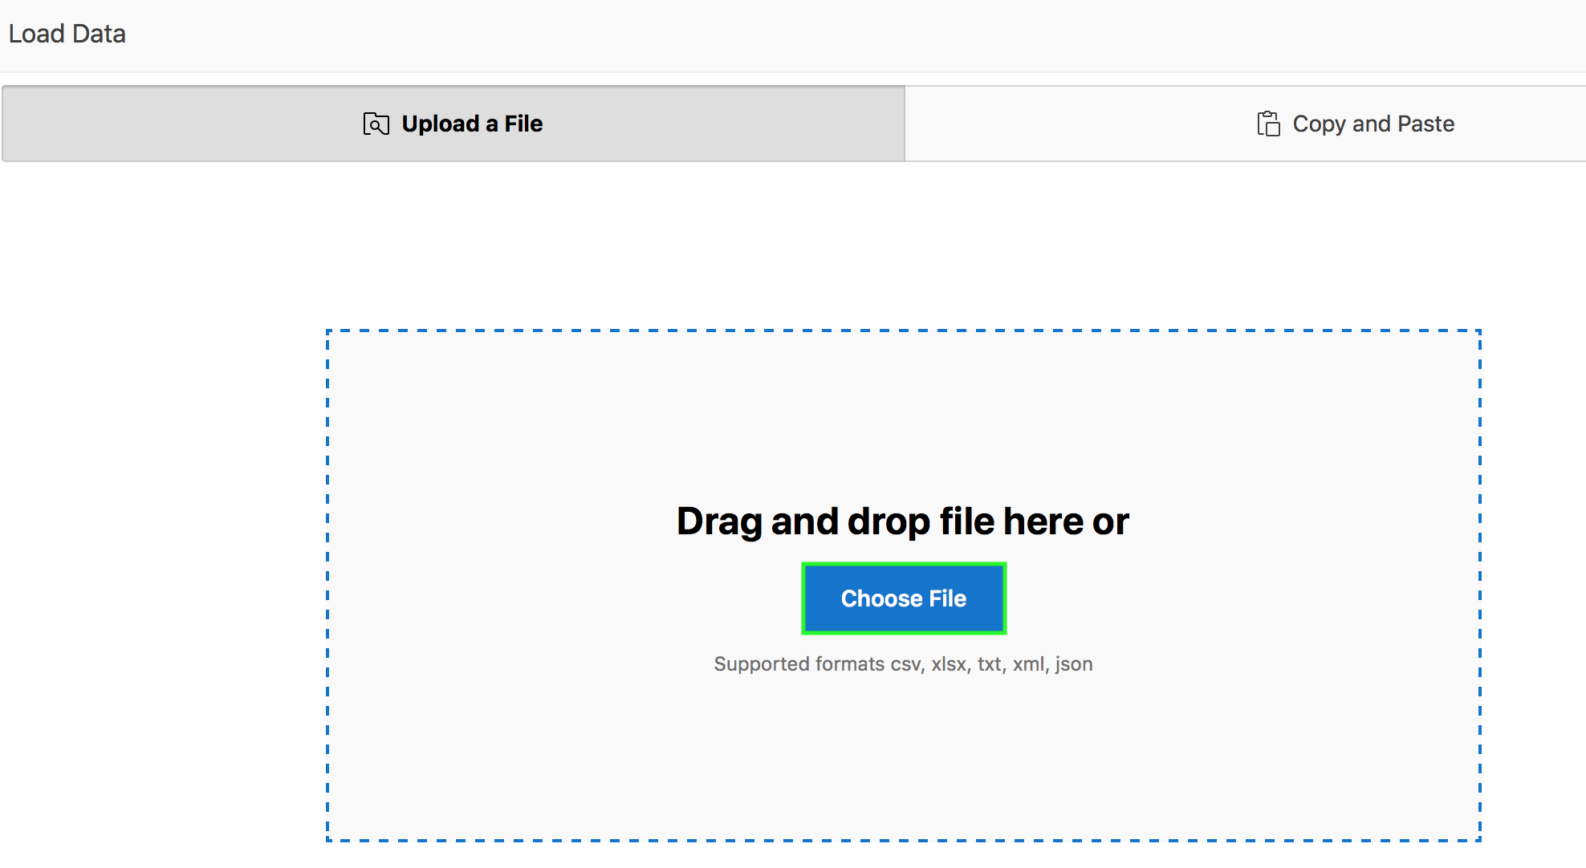
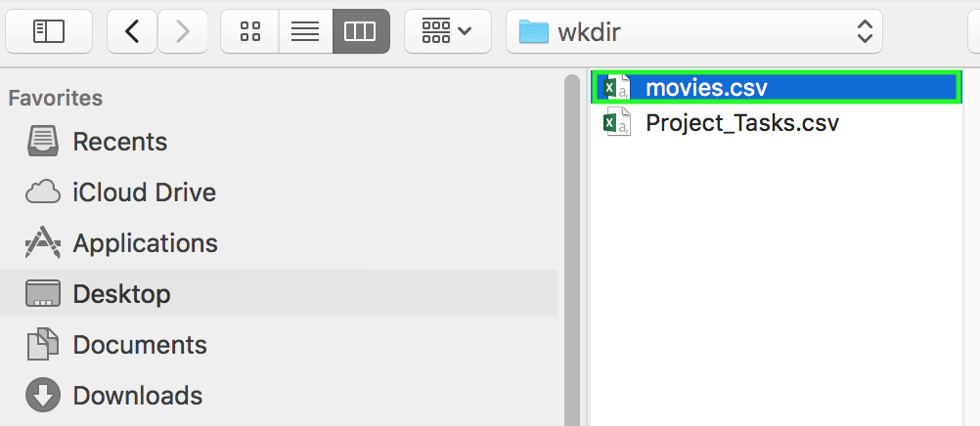
Loading Data: Example
1
2
Notes:
The slide shows an example of loading CSV data into the Oracle Application Express. In the slide example, you load the movies.csv file data. Navigate to SQL Workshop > Utilities, click Data Workshop, select Load Data and perform the following steps:
In the Load Data dialog, the Upload a File is selected by default. Click Choose File.
Navigate to your working directory and select the appropriate file. In the slide example, you select movies.csv. Instead of steps 1 and 2 above to upload a file, you can simply navigate to your working directory, select the appropriate file, then drag and drop that file in to the Load Data dialog.

Slide 22
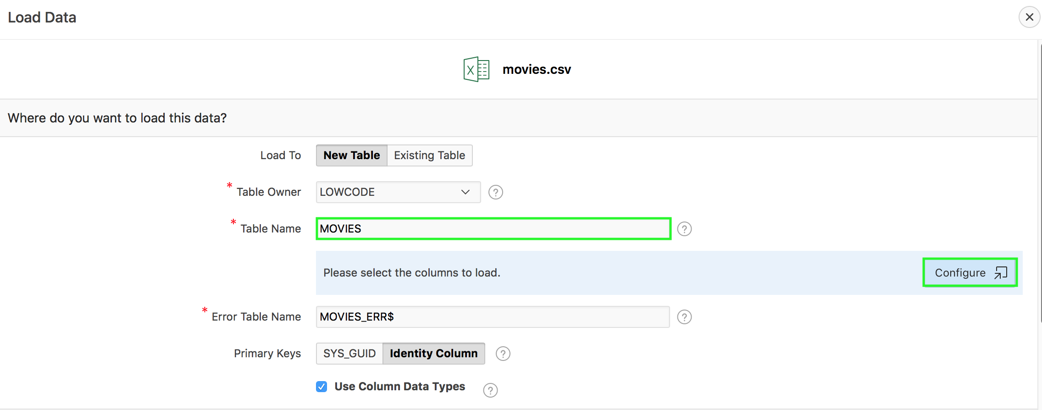
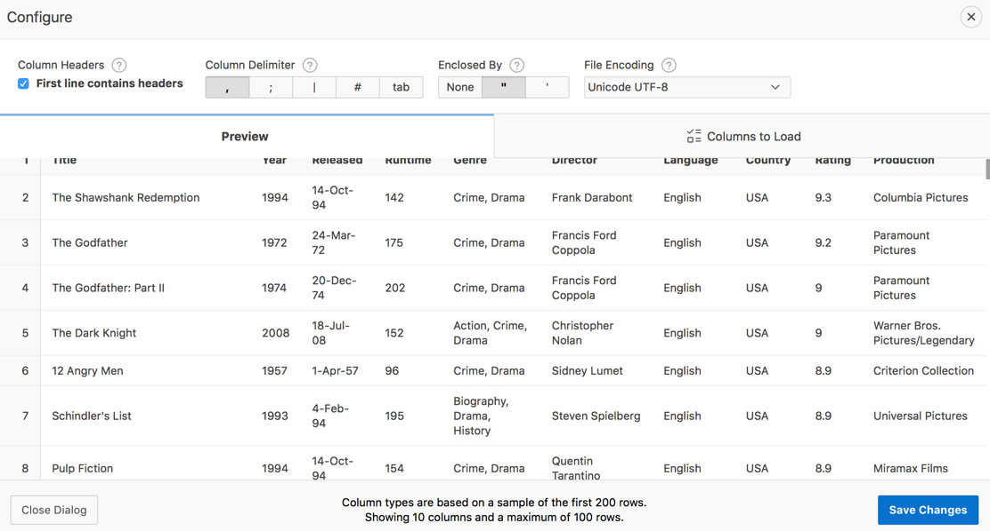
Loading Data: Example
3
4
Notes:
You can load data into a new table or an existing table. In the slide example, you accept the default selection, New Table. In the Load Data dialog, select or enter the following :
Table Owner - Select the database schema you would like to create and load data into.
Table Name - Enter the table name you would like to create. By default, all table names are converted to upper case.
Error Table Name - Enter the error table name you would like to save errors during data load. You can simply press the <tab> key. If data load succeeds without any error, this error table is dropped automatically.
In the slide example, enter movies for Table Name and press the <tab> key. You can configure load settings such as column headers, file encoding, column delimiter / enclosed by (for CSV or TXT), and Select Sheet (for XLSX with multiple worksheets). Click Configure to view full preview and change more settings.
Configure dialog displays maximum of 100 columns and 100 rows.
Note: In Configure dialog, under Columns to Load tab, you can enter case insensitive value that will be treated as NULL. For example, "tbd", "n/a", "unknown", "-". Make the appropriate changes and click Save Changes. In the slide example, you do not make any changes. Therefore, you click X to close the Configure dialog.

Slide 23
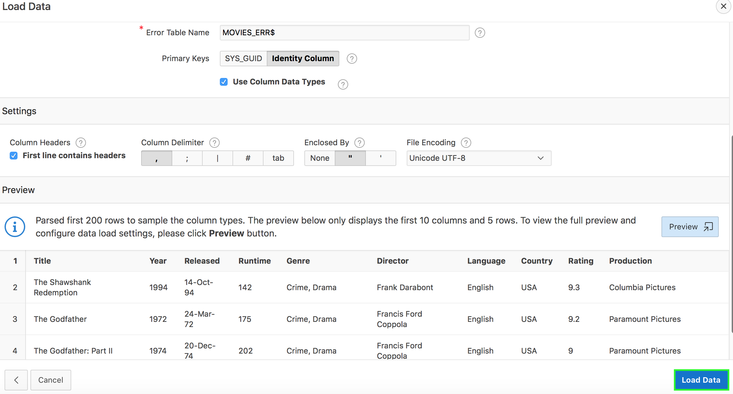
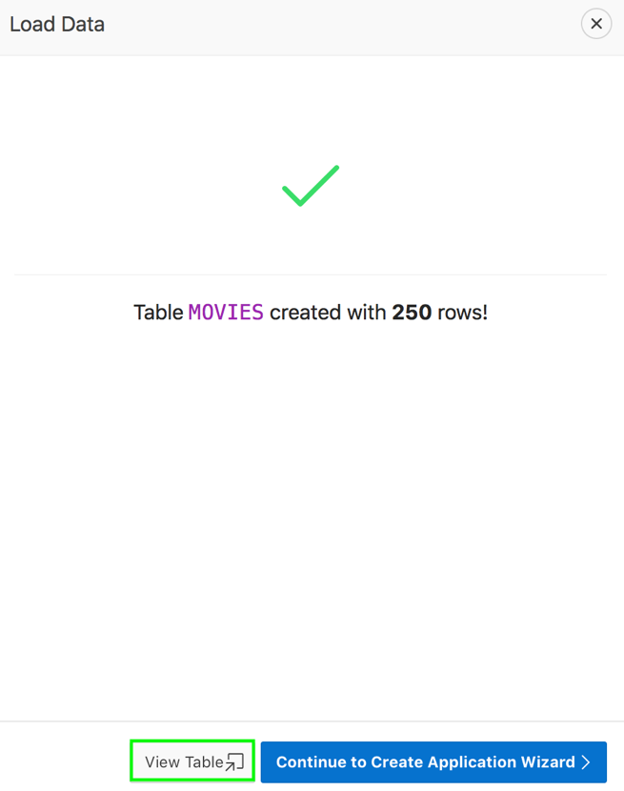
Loading Data: Example
6
5
6
Notes:
In the Load Data dialog, select or enter the following and scroll down:
Primary Keys - Select how to set the primary key (Oracle Database 12c or later). Primary keys can be set using SYS_GUID or Identity Column. SYS_GUID generates and returns a globally unique identifier. On most platforms, this generated identifier is based on a host identifier, a process or thread identifier of the process or thread invoking the function, and a non-repeating value (sequence of bytes). SYS_GUID consumes more space, but is unpredictable. Identity Column is compact, but can be predictable.
Use Column Data Types - Select to use the column types parsed from the file. If not selected, the table columns will be created as VARCHAR2(4000).
In the slide example, accept the default for Primary Keys, ensure that the Use Column Data Types checkbox is selected and click Load Data.
Notice that the table is now created with <n> rows. In the slide example, you see that the MOVIES table has been created with 250 rows. You want to view the table definition now. Click View Table.
. Use Column Data Types - Select to use the column types parsed from the file. If not selected, the table columns will be created as VARCHAR2(4000).

Slide 24
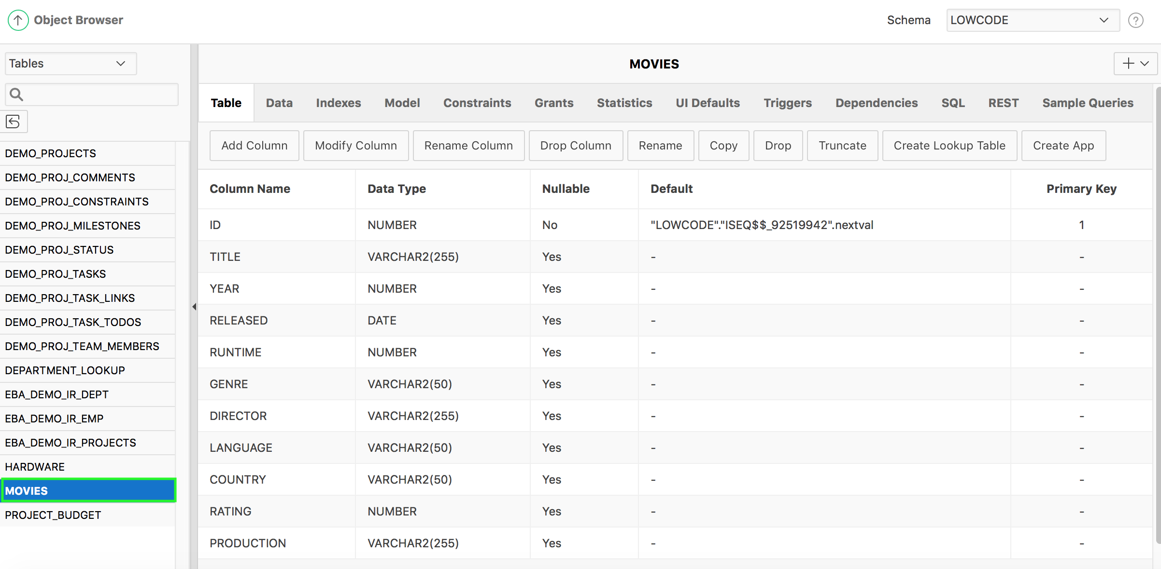
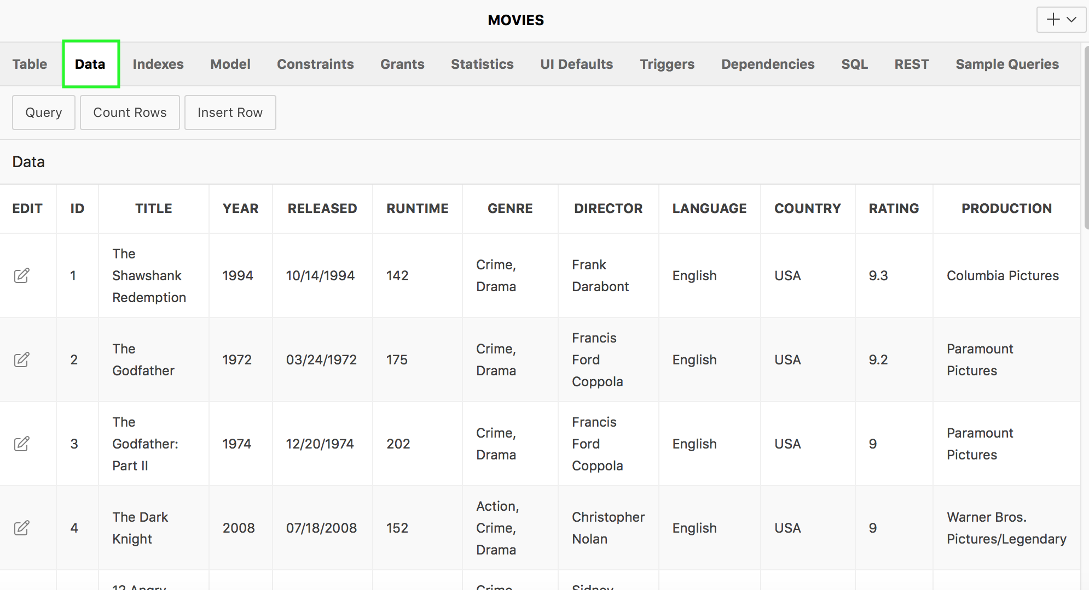
Loading Data: Example
7
8
Notes:
You are navigated to the Object Browser. View the table definition.
In the Detail pane, click Data to view the table data. In the slide example, you view the MOVIES table data.

Slide 25
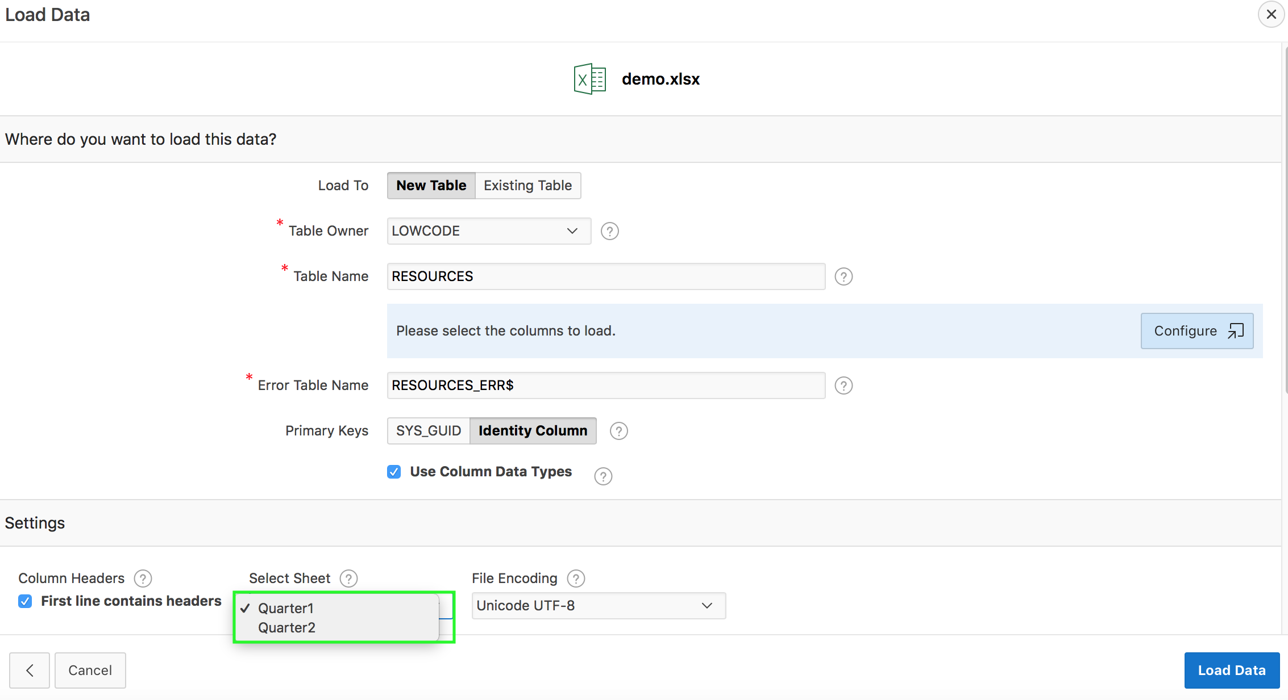
Loading XLSX Data: Example
Notes:
The slide shows an example of loading an XLSX file containing two worksheets. The wizard picks up the first sheet by default. You click Select Sheet to select another sheet to be loaded.
Loading XLSX files is similar to loading CSV files. There is no need to detect or to choose delimiter or enclosing characters.
To load a XLSX file:
On the Workspace home page, click the SQL Workshop icon.
Click Utilities.
Click Data Workshop.
Click Load Data.
Under Upload a File, Click Choose File.
Select the appropriate XLSX file. Follow the on-screen instructions.
If the uploaded XLSX file contains multiple worksheets, Load Data wizard picks the first sheet by default. To load another sheet, pick it from the Select Sheet select list. The First lines contains headers checkbox works similar to CSV files. The same is true for the Configure dialog, the behaviour is the same as it is for CSV files. Uploading XLSX files is limited to 20MB for each file.

Slide 26
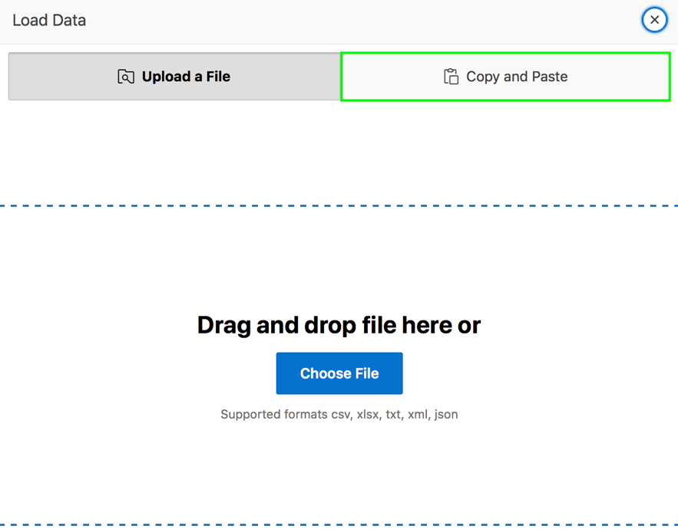
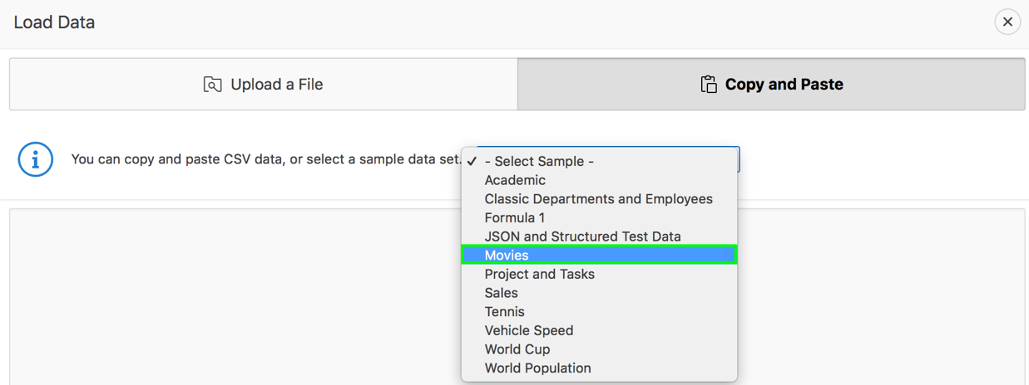
Selecting a Sample Data Set: Example
1
2
Notes:
The slide shows an example of loading a sample data set in to the Oracle Application Express.
You can copy and paste CSV data, or select a sample data set sample into the Load Data Wizard.
To load data by copying and pasting CSV data or selecting a sample data set navigate to SQL Workshop > Utilities. Then, click Data Workshop and select Load Data. Perform the followings steps:
Click Copy and Paste.
Under Copy and Paste, you can either copy and paste CSV data or select a sample data set from the drop down menu. In the slide example, click - Select Sample – and select a data set. For example, select Movies as you see in the slide.

Slide 27
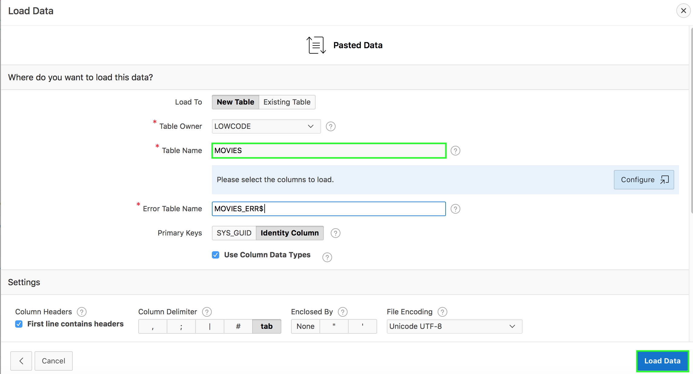
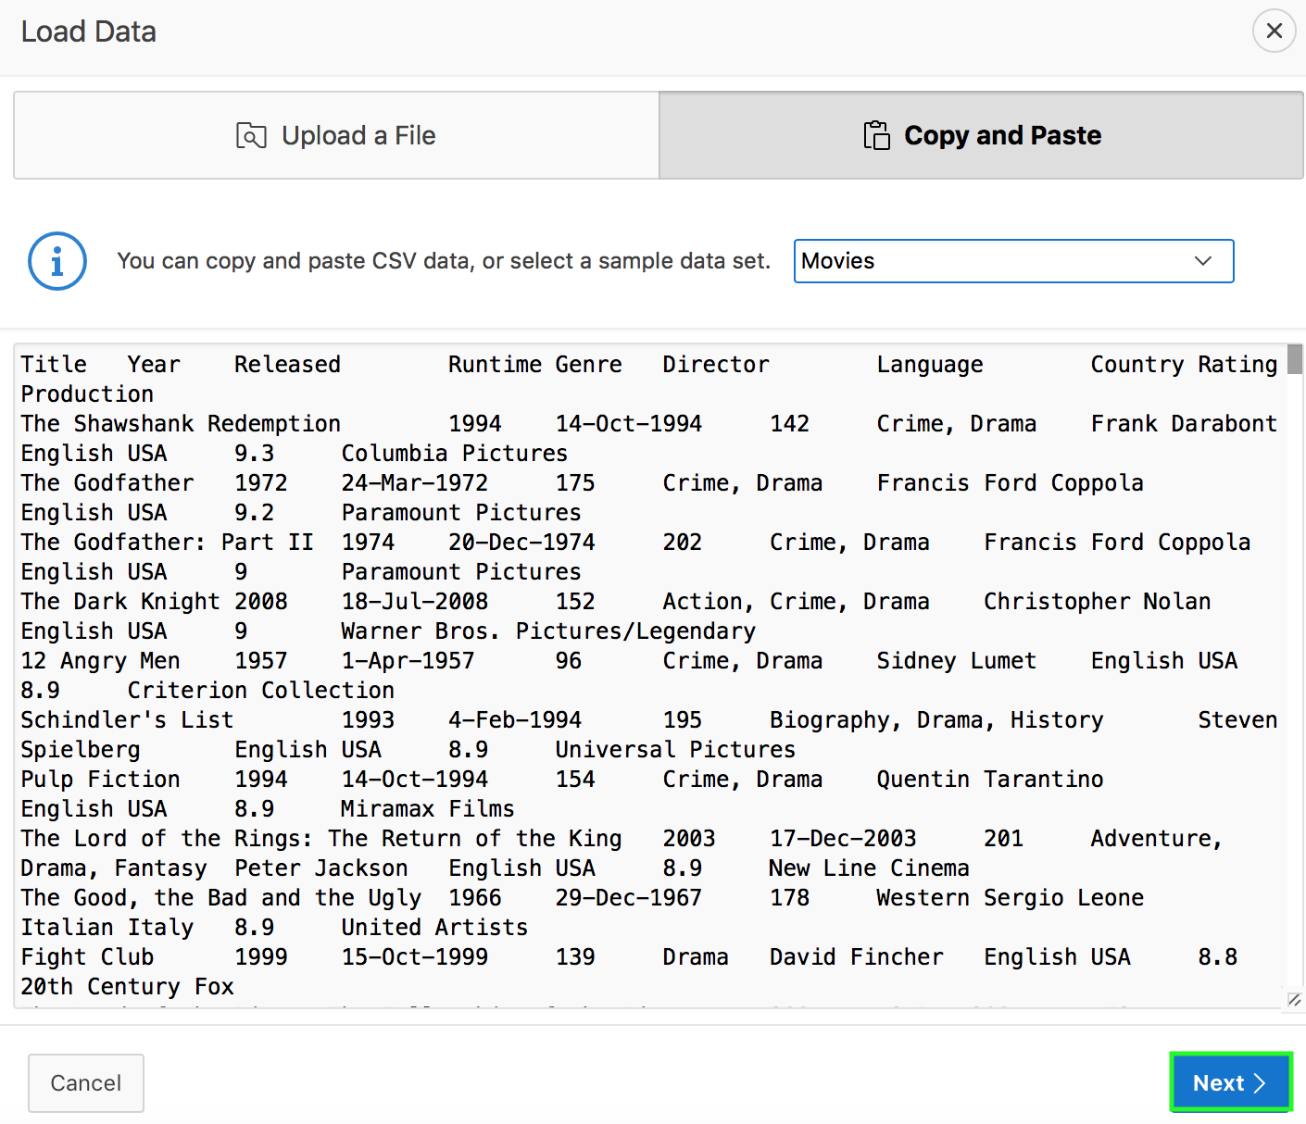
Selecting a Sample Data Set: Example
4
3
Notes:
The sample data is now loaded. Click Next.
Notice that the Load Data dialog now displays "Pasted Data" and not the file name. You can load data either into a new table or an existing table. Follow the on-screen instructions and click Load Data. In the slide example, you accept the default selection of New Table. In the example, you enter MOVIES for Table Name.

Slide 28
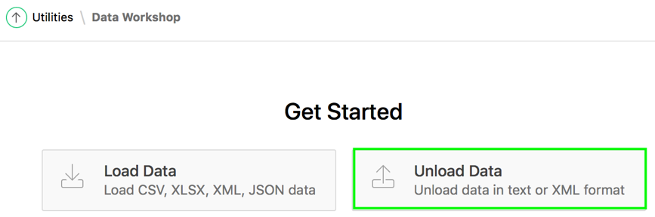
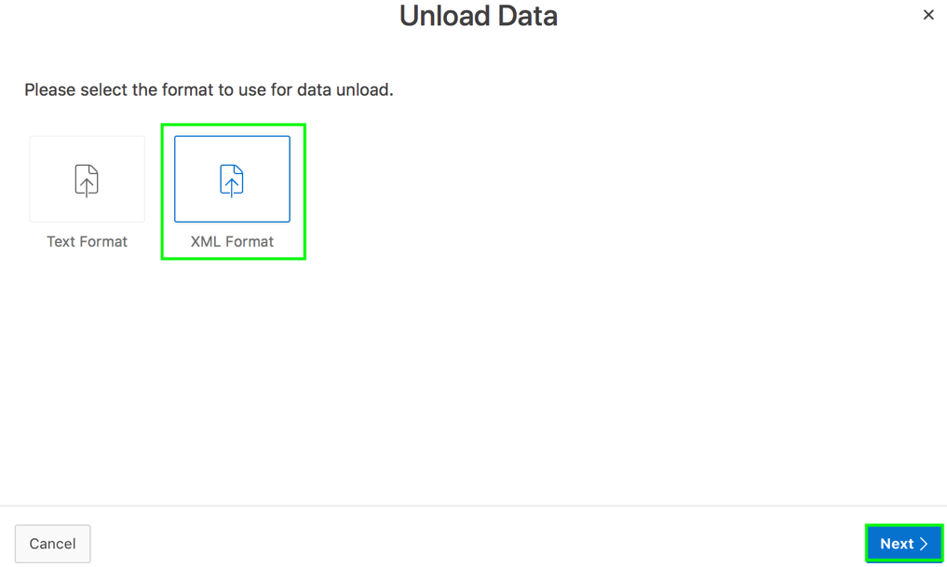
Unloading Data Using Data Workshop: Example
1
Use the Unload Data page to export the contents of a table to a text file or XML document.
2
Notes:
You use the Unload Data page to export the contents of a table to a text file or XML document.
You can export an entire table to a comma-delimited file (.csv). You can export the contents of a table to an XML document adhering to
the Canonical XML specification.
The slide shows an example of how to unload a table to an XML document. Navigate to SQL Workshop > Utilities > Data
Workshop, and then perform the following steps:
Click Unload Data. The Unload DataWizard appears.
Select XML Format and click Next.

Slide 29
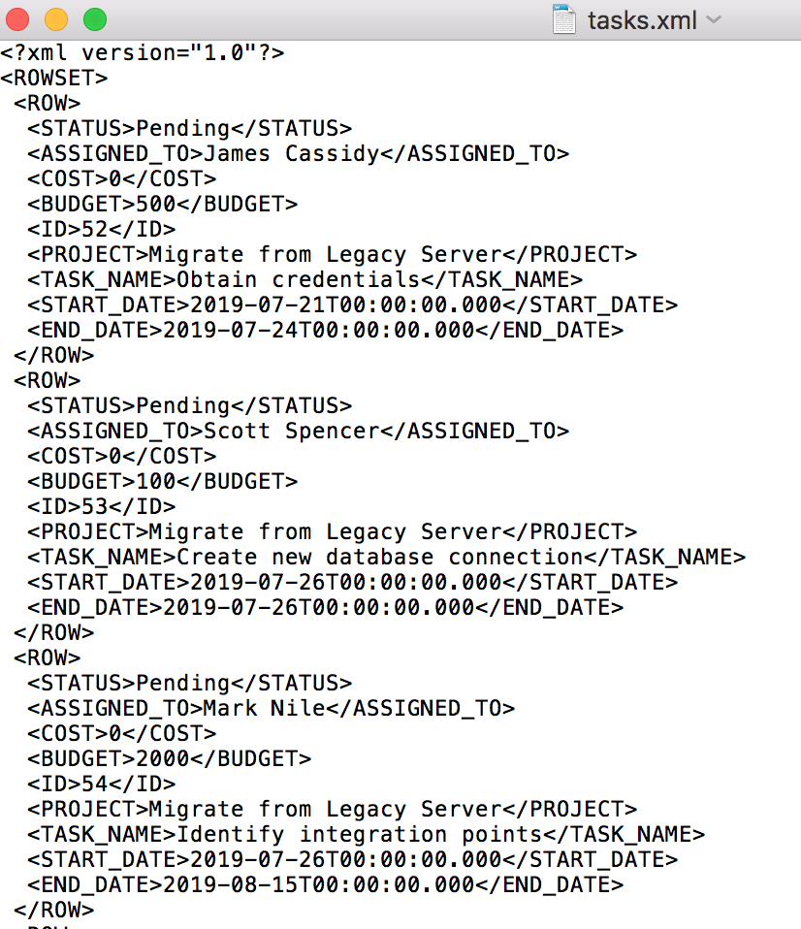

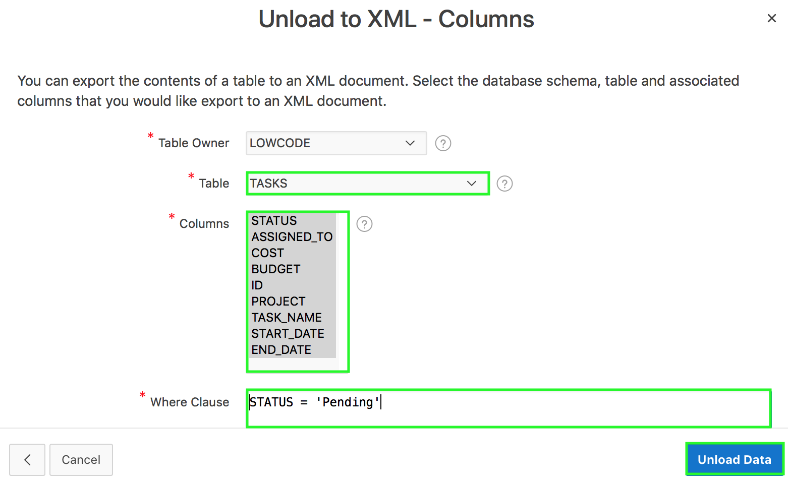
Unloading Data Using Data Workshop: Example
5
3
4
Notes:
The Unload to XML – Columns appears. Select the table to unload. Highlight the columns to include. Optionally enter a Where Clause to limit the records unloaded, and click Unload Data.
The file is downloaded.
Open the XML file to view the downloaded data.

Slide 30
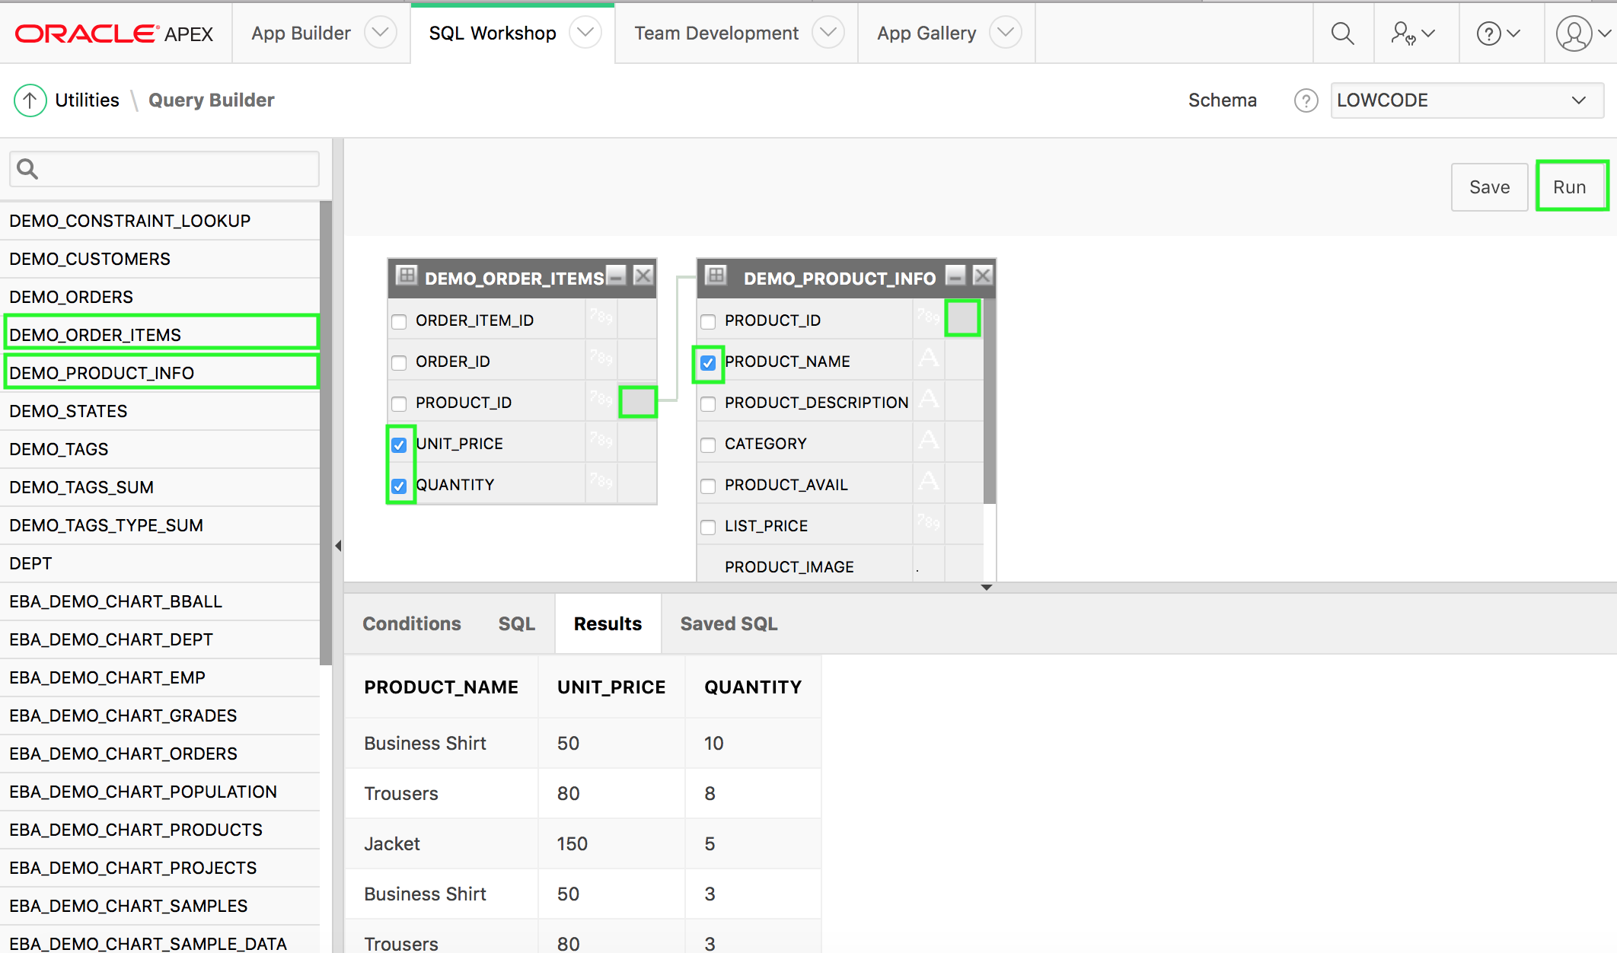
Building a Query Using Query Builder
4
Object selection pane
1
3
Design pane
2
Output pane
Notes:
Query Builder's graphical user interface enables database developers to build SQL queries without the need for manual SQL coding. Using Query Builder, you can search and filter database objects, select objects and columns, create relationships between objects, view formatted query results, and save queries with little or no SQL knowledge. The Query Builder page is divided into three sections:
Object Selection pane displays on the left side of the page and contains a list objects from which you can build queries. Only objects in the current schema display.
Design pane displays to the right of the Object Selection pane and above the Conditions, SQL, Results, and Saved SQL tabs. When you select an object from the Object Selection pane, it appears in the Design pane.
Output pane displays below the Design pane. Once you select objects and columns, you can create conditions, view the generated SQL, or view query results.
To access Query Builder:
On the Workspace home page, click SQL Workshop.
Click Utilities.
Click Query Builder.
The slide shows steps to create and run a query which is a join between the two tables: DEMO_ORDER_ITEMS and DEMO_PRODUCT_INFO.
In the object selection pane, select the objects from which you want to display data
Select the checkboxes for the columns you want to include in the query
Create a join by clicking the join column in the first table followed by the same join column in the second table
Click the Run button to view the results in the output pane

Slide 31
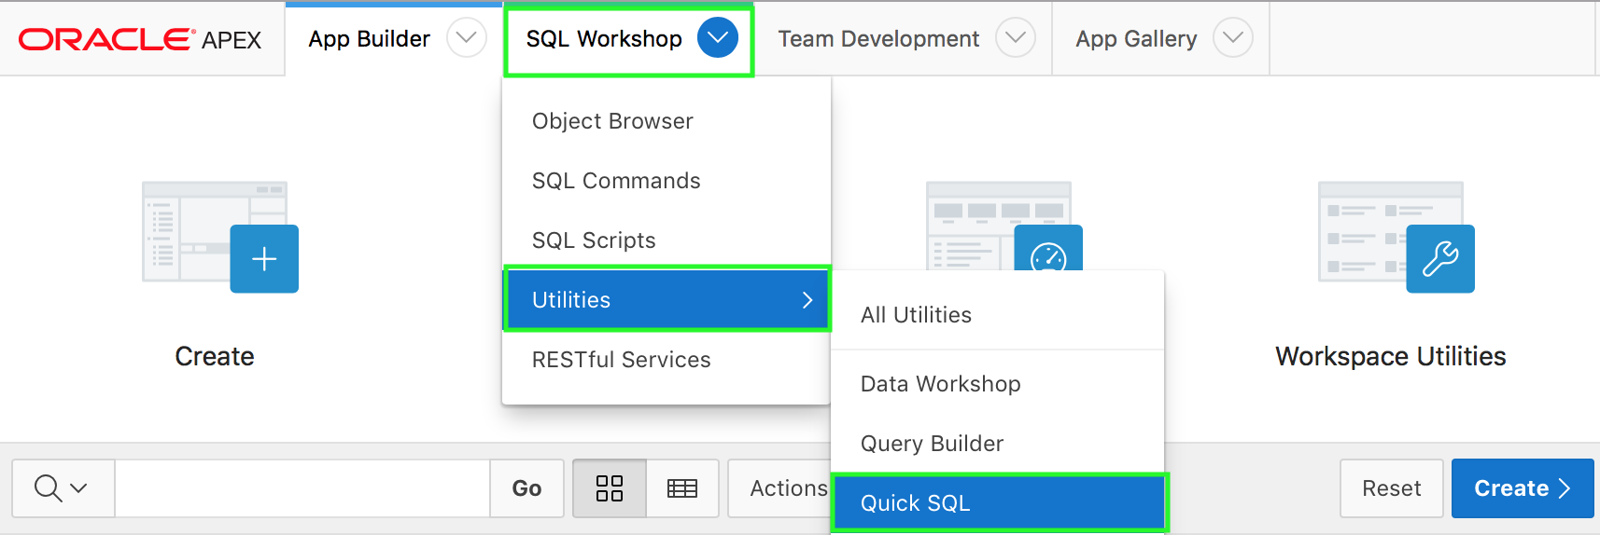

Using Quick SQL
Quick SQL provides a quick way to generate the SQL required to create a relational data model from an indented text document.
SQL Workshop > Utilities
SQL Workshop > SQL Scripts
Notes:
Quick SQL enables you to rapidly design and prototype data models using a markdown-like shorthand syntax that expands to standards-based Oracle SQL. You can easily create master detail relationships, check constraints, and even generate sample data.
This tool is designed to reduce the time and effort required to create SQL tables, triggers, and index structures. This tool is not designed to be a replacement for data modeling, it is simply a quick way to develop a script for simple tables and views. Once the SQL is generated it can be tweaked and expanded upon.
The following are the top use cases of Quick SQL:
Quickly create robust data models
Easily generate random data
Learn SQL create table, select, insert, index, trigger, PL/SQL package, and view syntax using provided examples
The slide shows the following two different ways of navigating to Quick SQL.
In your Workspace home page, click the SQL Workshop down arrow, select Utilities, and then click Quick SQL. Alternatively, in your Workspace home page, click SQL Workshop and then click Utilities. Now, click Quick SQL.
Navigate to SQL Workshop > SQL Scripts. Then, click Quick SQL.

Slide 32

Generating SQL Using Quick SQL: Example
1
Notes:
The slide shows an example of creating the DEPARTMENTS, EMPLOYEES, and SKILLS tables using indentation to identify parent and child tables. The example uses shorthand syntax VC255 and NUM to specify SQL data types.
In the Quick SQL Shorthand pane, you enter parent table names without any indention. Then, you enter table columns with a uniform indention of 2 or more spaces. Generally it is best to not specify primary keys, the system will generate them for you. Parent child relationships are created simply by indenting child tables under parent tables.
Navigate to Quick SQL and perform the following steps:
In the Quick SQL Shorthand pane, enter the following shorthand SQL syntax and then click Generate SQL. In the syntax, make sure you enter columns with a indention of 2 spaces.
department
name
location vc255
country vc255
employees
name
email
job vc255
hiredate
skills
skill vc255
proficiency num
Notice the SQL generated in the SQL pane. You see the CREATE TABLE statements for the three tables: DEPARTMENTS, EMPLOYEES, and SKILLS.

Slide 33


Generating SQL Using Quick SQL: Example
2
3
Notes:
Now you want to generate some random data in these three tables. You use the shorthand syntax /insert NN. In the slide, you enter 10 rows each for DEPARTMENTS, SKILLS table and 20 rows for the EMPLOYEES table.
When generating the random data for the SKILLS table, you want Quick SQL to use from within a comma separated list of values. You use the shorthand syntax /values. The slide example shows using /values C++, Java, APEX, JSON, Javascript, Python, and CSS. The example also shows how to specify a check constraint for the proficiency column in the SKILLS table. The shorthand syntax /check creates a check constraint with comma or white space delimited values.

Slide 34

Generating SQL Using Quick SQL: Example
4
5
Notes:
In the Quick SQL utility, you can enter inline settings to explicitly set SQL syntax generation options. Alternatively, you can click Settings at the top of the right pane to declaratively set the generation options. Entering settings directly into the Quick SQL Shorthand pane ensures the same SQL generation options are utilized even if you download the script and later paste it back. In the slide example, Click Settings.
You want all the Database object names to be prefixed with a value. In the slide example, for Object Prefix, enter LC.

Slide 35

Generating SQL Using Quick SQL: Example
6
Notes:
You want to add an additional created, created_by, updated and updated_by columns to every table created. Under Settings > Additional Columns > Include, select the checkbox for Audit Columns. You also want to include SQL commands to drop each database object created. In the slide example, under Settings > Options, select Yes for Include Drops. Then, click Save Changes.

Slide 36

Generating SQL Using Quick SQL: Example
7
Notes:
Your settings are saved. In the SQL pane, notice the drop table statements, and also the new audit columns added for each of the tables. You want to save this SQL as a script. Click Save SQL Script.

Slide 37


Generating SQL Using Quick SQL: Example
9
8
Notes:
In the Save Script dialog, enter a name for Script Name and click Save Script.
The script is saved under SQL Scripts. You want to run the script you just created. Click Review and Run.

Slide 38


Generating SQL Using Quick SQL: Example
10
11
Notes:
Click Run.
Review the information and click Run Now.

Slide 39


Generating SQL Using Quick SQL: Example
12
Notes:
Review the summary. To view the details, select the Detail radio button and click Go.
Note: You can directly run the Create Application Wizard from SQL Scripts page. To create a database application from the script, you can click the Create App from Script button. You learn how to create a database application later in this course.
Note: In the slide example, you see errors in the summary because the tables don't exist already and the DROP TABLE statements are executed.

Slide 40


Generating DDL Statements
1
3
2
Notes:
With Oracle Application Express, you can generate data definition language (DDL) statements from the Oracle data
dictionary. You can use these scripts to create or re-create database schema objects. This is particularly useful when moving
database objects from one environment to another, for example from development to test or production. The scripts can be
generated to display inline or saved as a script file.
You can generate DDL statements for:
All the objects for a specific schema
Specific object types
Specific objects
To generate a DDL script, navigate to SQL Workshop > Utilities and then perform the following steps:
Click Generate DDL.
Click Create Script.
In the Generate DDL – Schema dialog, Select the database schema which owns the database objects for which you would like to generate a DDL script. Click Next.

Slide 41



Generating DDL Statements
4
5
Notes:
Select the object types for which you would like to generate DDL. Clicking Generate DDL at this point generates DDL for the selected object types. If you want to select object names for selected object types, click Next.
Select the objects. Click Generate DDL.
View the generated script.

Slide 42
Summary
In this lesson, you learned how to:
Navigate to SQL Workshop and review its components
Browse through database objects using the Object Browser
Create a lookup table
Run SQL commands and SQL scripts
Load and unload data using the Data Workshop utility
Build a SQL query using Query Builder
Generate SQL using Quick SQL
Generate DDL statements
Notes:
In this lesson, you learned how to interact with the database using the SQL Workshop components.

Slide 43


Slide 44
Hands-on Lab

